Slide 1
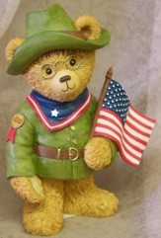
THE PROGRESSIVE ERA 1900-1920
AMERICA SEEKS REFORMS IN THE EARLY 20TH CENTURY

Slide 2
ORIGINS OF PROGRESSIVISM
As America entered into the 20th century, middle class reformers addressed many social problems
Work conditions, rights for women and children, economic reform, environmental issues and social welfare were a few of these issues

Slide 3
FOUR GOALS OF REFORMERS
1) Protect Social Welfare
2) Promote Moral Improvement
3) Create Economic Reform
4) Cleaning up Government

Slide 4
1.PROTECT SOCIAL WELFARE
Industrialization in the late 19th century was largely unregulated
Employers felt little responsibility toward their workers
As a result Settlement homes and churches served the community
Also the YMCA and Salvation Army took on service roles

Slide 5
PROTECTING WORKING CHILDREN
As the number of child workers rose, reformers worked to end child labor
Children were more prone to accidents caused by fatigue
Nearly every state limited or banned child labor by 1918 under the Keating-Owens Act

Slide 6
EFFORTS TO LIMIT HOURS
The Supreme Court and the states enacted or strengthened laws reducing women’s hours of work
Progressives also succeeded in winning worker’s compensation to aid families of injured workers

Slide 9
2. PROMOTE MORAL DEVELOPMENT
Some reformers felt that the answer to societies problems was personal behavior
Censored movies, outlawed Prostitution
They proposed such reforms as prohibition
Groups wishing to ban alcohol included the Woman’s Christian Temperance Union (WCTU)

Slide 10
3. CREATE ECONOMIC REFORM
The Panic of 1893 prompted some Americans to question the capitalist economic system
As a result some workers embraced socialism
Eugene Debs organized the American Socialist Party in 1901
Debs encouraged workers to reject American Capitalism

Slide 11
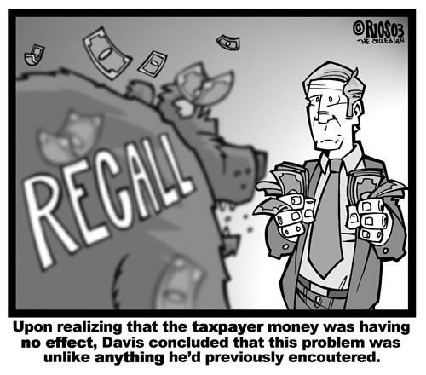
4. Cleaning up State Government
Desire to make government more efficient and responsive to citizens. Government should be the STEWARD of the People!
Citizens could petition and get initiatives on the ballot
Once on the ballot they were called referendums and could actually become LAW!
Citizens fought for, and won, such measures as secret ballots and the recall

Slide 12
DIRECT ELECTION OF SENATORS
To force senators to be more responsive to the public, progressives pushed for the popular election of senators
As a result, Congress passed the 17th Amendment (1913)

Slide 13
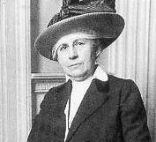
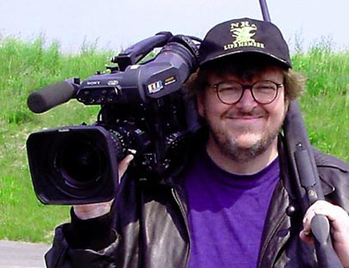
MUCKRAKERS CRITICIZE BIG BUSINESS
Ida Tarbell
Journalists known as “Muckrakers” exposed corruption in business
Ida Tarbell exposed Standard Oil Company’s cut-throat methods of eliminating competition
Some view Michael Moore as a modern muckraker

Slide 14
SECTION 2: WOMEN IN PUBLIC LIFE
Before the Civil War, American women were expected to devote their time to home and family
By the late 19th and early 20th century, women were visible in the workforce

Slide 15
DOMESTIC WORKERS
Before the turn-of-the-century women without formal education contributed to the economic welfare of their families by doing domestic work
Altogether, 70% of women employed in 1870 were servants

Slide 16
WOMEN IN THE WORK FORCE
Opportunities for women increased especially in the cities
By 1900, one out of five women worked
The garment trade was popular as was office work, department stores and classrooms

Slide 17
WOMEN LEAD REFORM
Many of the leading progressive reformers were women
Middle and upper class women also entered the public sphere as reformers
Many of these women had graduated from new women’s colleges
Colleges like Vassar and Smith allowed women to excel

Slide 18
WOMEN AND REFORM
Women reformers strove to improve conditions at work and home
In 1896, black women formed the National Association of Colored Women (NACW)
Suffrage was another important issue for women

Slide 19
THREE-PART STRATEGY FOR WINNING SUFFRAGE
Suffragists tried three approaches to winning the vote
1) Convince state legislatures to adopt vote (Succeeded in Wyoming, Utah, Idaho, Colorado)
2) Pursue court cases to test 14th Amendment
3) Push for national constitutional Amendment

Slide 20
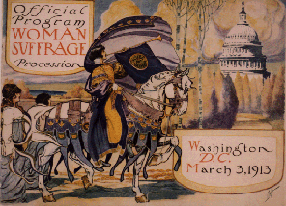

Slide 21
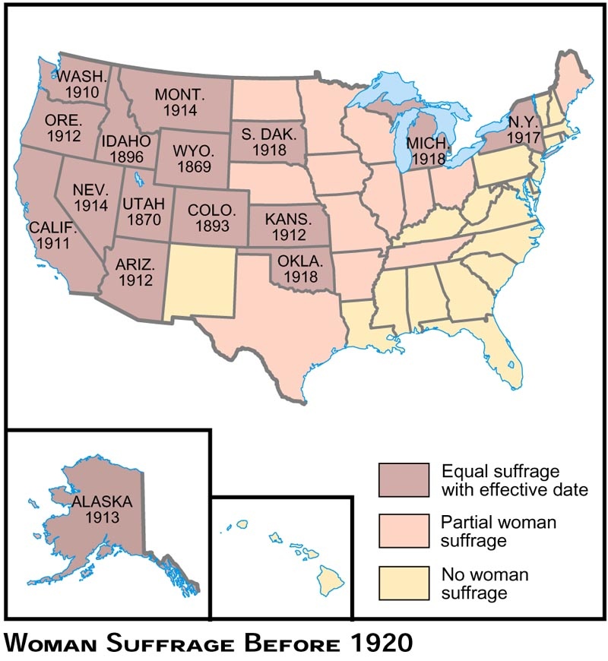

Slide 22
SECTION 3: TEDDY ROOSEVELT’S SQUARE DEAL
When President William McKinley was assassinated 6 months into his second term, Theodore Roosevelt became the nations 26th president
McKinley was assassinated by an anarchist in Buffalo in September of 1901

Slide 23
ROOSEVELT AND THE ROUGH RIDERS
Roosevelt grabbed national attention by advocating war with Spain in 1898
His volunteer cavalry brigade, the Rough Riders, won public acclaim for its role in the battle at San Juan Hill in Cuba
Roosevelt returned a hero and was soon elected governor of NY and later McKinley’s vice-president

Slide 24
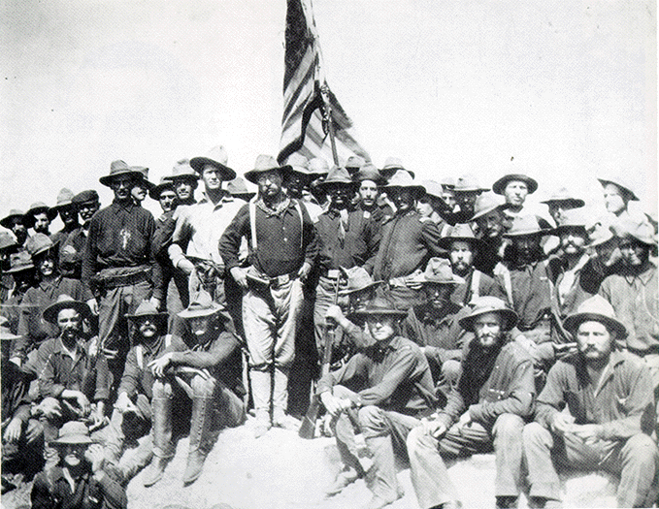
Teddy Roosevelt and the Rough Riders

Slide 25
THE MODERN PRESIDENT
When Roosevelt was thrust into the presidency in 1901, he became the youngest president ever at age 42
He quickly established himself as a modern president who could influence the media and shape legislation

Slide 26
TRUSTBUSTING
By 1900, Trusts – legal bodies created to hold stock in many companies – controlled 80% of U.S. industries
Roosevelt filed 44 antitrust suits under the Sherman Antitrust Act

Slide 27
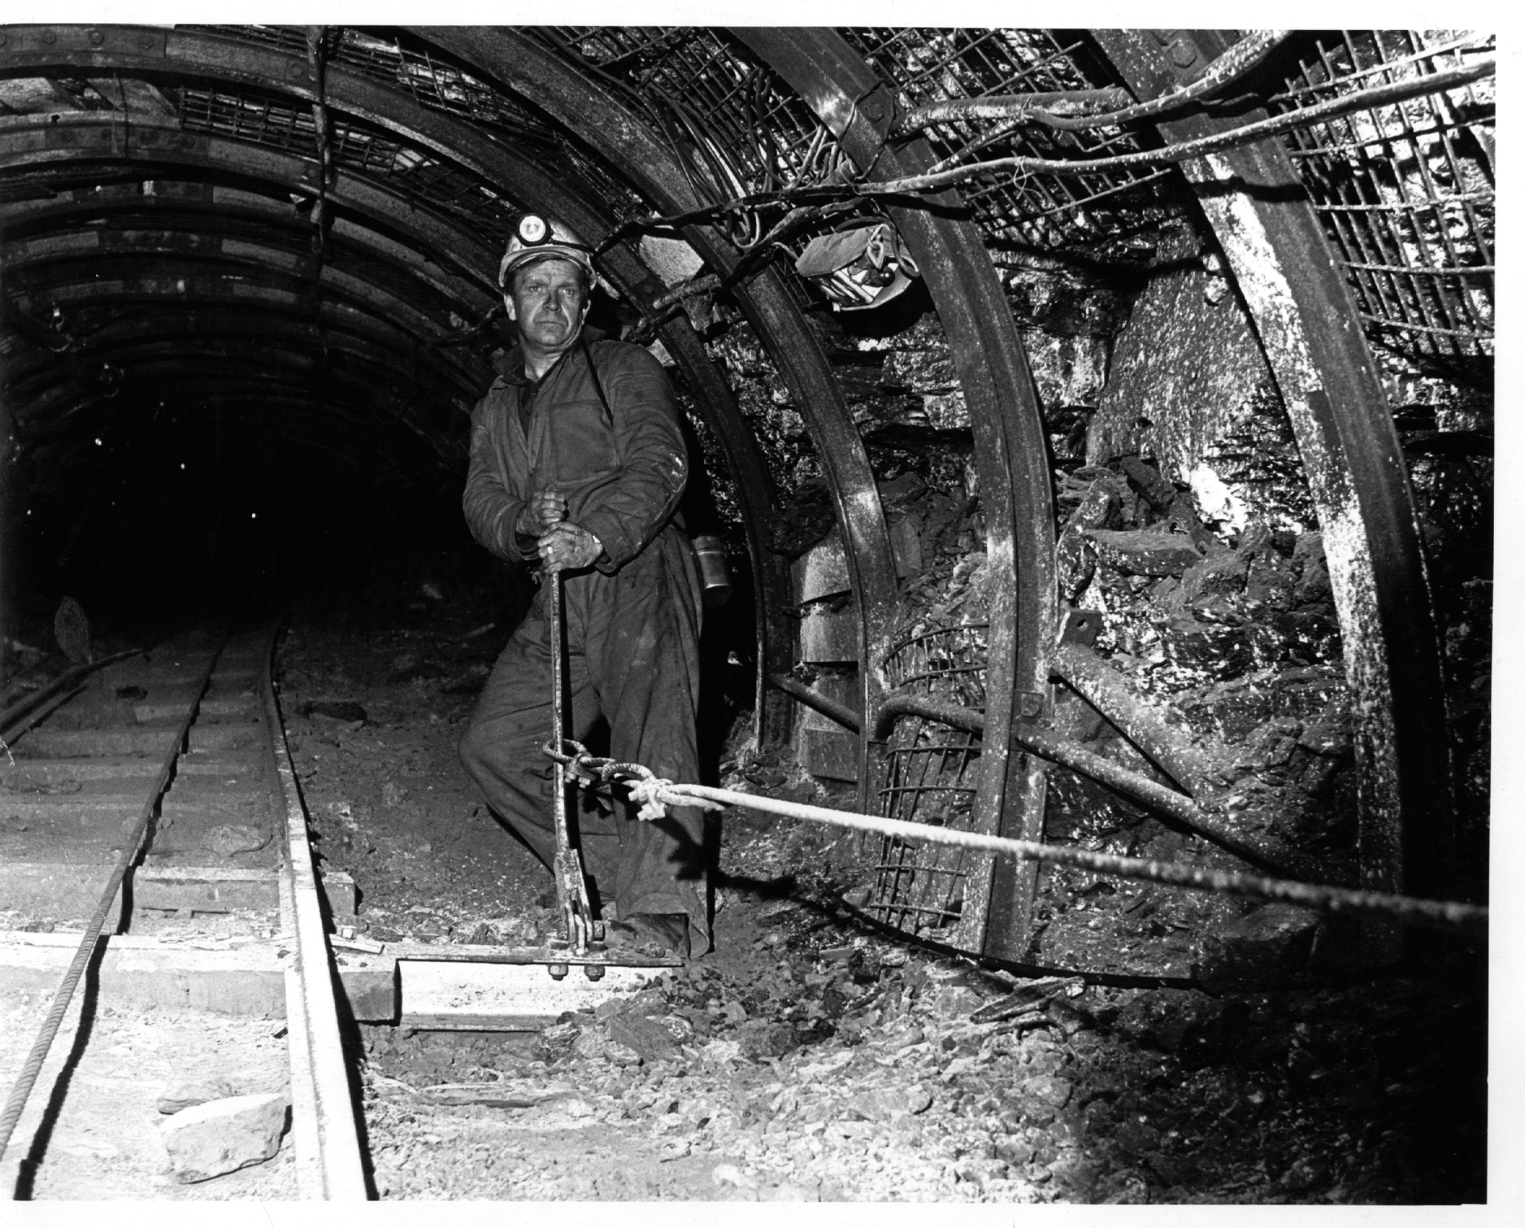
1902 COAL STRIKE
In 1902 140,000 coal miners in Pennsylvania went on strike for increased wages, a 9-hour work day, and the right to unionize
Mine owners refused to bargain
Roosevelt called in both sides and settled the dispute
Thereafter, when a strike threatened public welfare, the federal government was expected to step in and help

Slide 28
“THE JUNGLE” LEADS TO FOOD REGULATION
After reading The Jungle by Upton Sinclair, Roosevelt pushed for passage of the Meat Inspection Act of 1906
The Act mandated cleaner conditions for meatpacking plants

Slide 30
PURE FOOD AND DRUG ACT
In response to unregulated claims and unhealthy products, Congress passed the Pure Food and Drug Act in 1906
The Act halted the sale of contaminated foods and medicines and called for truth in labeling
The Pure Food and Drug Act took medicines with cocaine and other harmful ingredients off the market

Slide 31
ROOSEVELT AND THE ENVIRONMENT
Before Roosevelt’s presidency, the federal government paid very little attention to the nation’s natural resources
Roosevelt made conservation a primary concern of his administration
Roosevelt, left, was an avid outdoorsman – here he is with author John Muir at Yosemite Park

Slide 32
ROOSEVELT’S ENVIROMENTAL ACCOMPLISHMENTS
Roosevelt set aside 148 million acres of forest reserves
He also set aside 1.5 million acres of water-power sites and he established 50 wildlife sanctuaries and several national parks
Yellowstone National Park, Wyoming

Slide 33
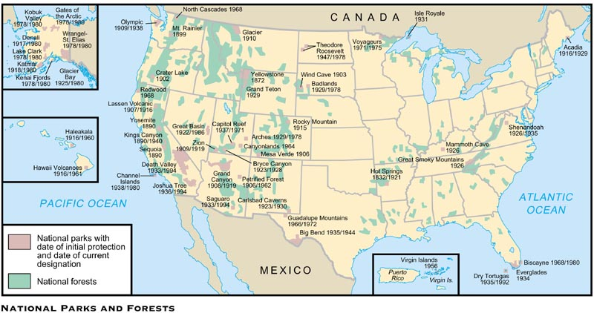

Slide 34
ROOSEVELT AND CIVIL RIGHTS
Roosevelt failed to support Civil Rights for African Americans
He did, however, support a few individuals such as Booker T. Washington

Slide 35
NAACP FORMED TO PROMOTE RIGHTS
In 1909 a number of African Americans and prominent white reformers formed the National Association for the Advancement of Colored People
The NAACP had 6,000 members by 1914
The goal of the organization was full equality among the races
The means to achieve this was the court system
1964 Application

Slide 38
SECTION 4: PROGRESSIVISM UNDER PRESIDENT TAFT
Republican William Howard Taft easily defeated Democrat William Jennings Bryan to win the 1908 presidential election
Among his accomplishments, Taft “busted” 90 trusts during his 4 years in office
Taft, right, was Roosevelt’s War Secretary

Slide 39
TAFT LOSES POWER
Taft was not popular with the American public nor reform minded Republicans
By 1910, Democrats had regained control of the House of Representatives
Taft called the Presidency, “The lonesomest job in the world”

Slide 40
1912 ELECTION
Republicans split in 1912 between Taft and Teddy Roosevelt (who returned after a long trip to Africa)
Convention delegates nominated Taft
Some Republicans formed a third party – The Bull Moose Party and nominated Roosevelt
The Democrats put forward a reform - minded New Jersey Governor, Woodrow Wilson
Republicans split in 1912

Slide 41
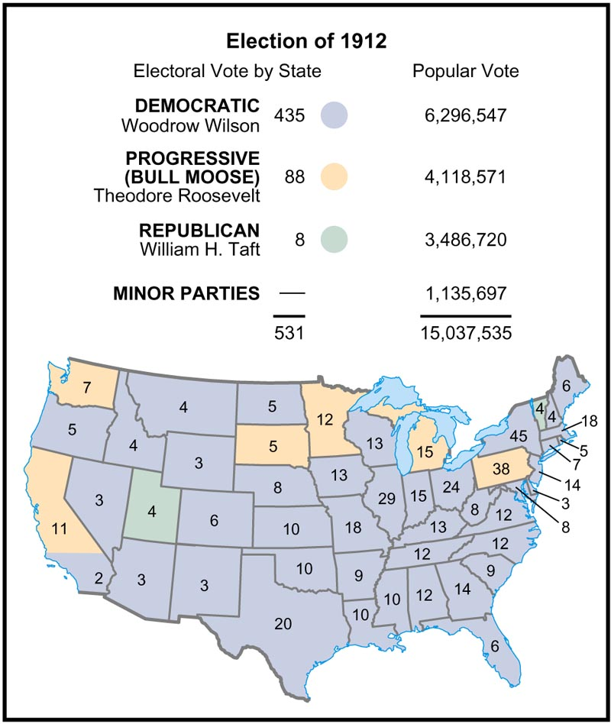

Slide 42
WILSON’S NEW FREEDOM
As America’s newly elected president, Wilson moved to enact his program, the “New Freedom”
He planned his attack on what he called the triple wall of privilege: trusts, tariffs, and high finance
W. Wilson U.S. President 1912-1920

Slide 43
CLAYTON ANTITRUST ACT
In 1914 Congress enacted the Clayton Antitrust Act which strengthened the Sherman Act
The Clayton Act prevented companies from acquiring stock from another company (Anti-monopoly)
The Act also supported workers unions

Slide 44
FEDERAL TRADE COMMISSION FORMED
The FTC was formed in 1914 to serve as a “watchdog” agency to end unfair business practices
The FTC protects consumers from business fraud
Today the FTC has been working on protecting consumers from ID theft

Slide 45
FEDERAL INCOME TAX ARRIVES
Wilson worked hard to lower tariffs, however that lost revenue had to be made up
Ratified in 1916, the 16th Amendment legalized a graduated federal income tax

Slide 46
WOMEN WIN SUFFRAGE
Native-born, educated, middle-class women grew more and more impatient
Through local, state and national organization, vigorous protests and World War I, women finally realized their dream in 1920
The 19th Amendment gave women the right to vote in 1920

Slide 47
LIMITS OF PROGRESSIVISM
While the Progressive era was responsible for many important reforms, it failed to make gains for African Americans
Like Roosevelt and Taft, Wilson retreated on Civil Rights once in office
The KKK reached a membership of 4.5 million in the 1920s

