Slide 1
Articles of Confederation (AOC)
The Articles of Confederation (1781-1789), written by the Second Continental Congress in November of 1777, became the first national constitution for governing the American states.
The Articles created a confederation of “league of friendship” among the states.
The Confederation would be composed of a relatively weak national government with a unicameral legislature.
Writers of the Articles did not want to replicate the strong national government of Great Britain.

Slide 2
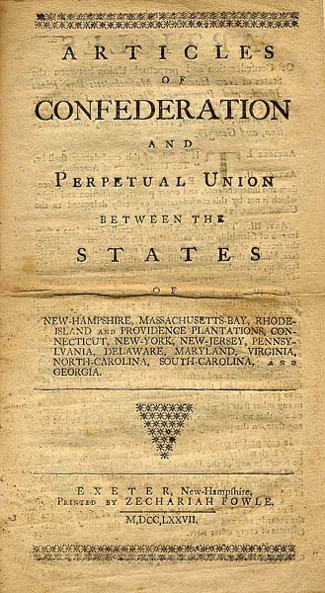
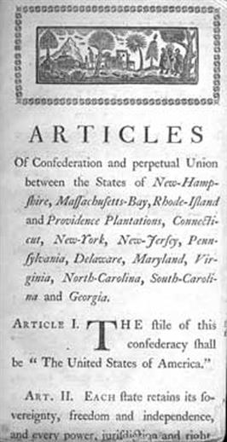

Slide 3
Congress would have limited powers such as borrowing money, creating a national army and navy, declaring war, creating post offices, and signing treaties with foreign governments.
Congress was not given the power to tax, draft soldiers for military service, or regulate commerce.
There was no national executive or judicial branch under the Articles of confederation. Each state was equal, with one vote, regardless of population or size.
The votes of 9 of the 13 states were required for legislation to pass the Confederation Congress; amending the Articles of Confederation required a unanimous vote.

Slide 4
The weaknesses evident in the Articles of Confederation allowed the states to focus on their own powers.
With no central government to control them, the states taxed each other, printed their own money, made treaties with foreign governments, and often refused to uphold the laws of the Confederation government.

Slide 5
Even with all these problems, the Confederation Congress was able to approve the signing of the Treaty of Paris, which ended the American Revolution in 1783, and pass the Land Ordinance of 1785 and Northwest Ordinance of 1787.
The government under the Articles of Confederation, however, could not deal with the nationals problems.
Economic chaos and violence broke out, resulting in conferences at Mt. Vernon and Annapolis.
These meetings proved to be unsuccessful, and eventually a rebellion of farms in Massachusetts (Shays Rebellion) led to the calling of a Constitutional

Slide 6
Problems with the Articles
Weakness | Outcomes
Congress has no power to enforce its laws | The government depended on the states to enforce the laws (which wouldn’t always happen).
Approval of 9 states is needed to enact new laws. | Difficult to create new laws because so many must agree
New Amendments to the Articles required the consent of all 13 states | Very difficult to change the powers of the government
The government has no Executive Branch (President) | Nobody to coordinate the work of the government.
No national court system (Supreme Court) | The central government can’t settle disputes between the states.
Congress has no power to lay or collect taxes | The Government is always short of money
Each state has only 1 vote | Larger states with the majority of the population don’t get more of a voice.

Slide 7
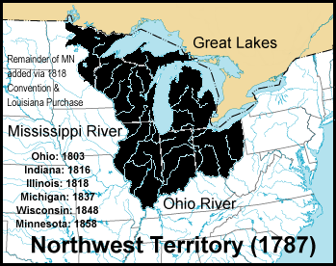
Even with all these problems, the Confederation Congress was able to approve the signing of the Treaty of Paris, which ended the American Revolution in 1783, and pass the Land Ordinance of 1785 and Northwest Ordinance of 1787. The government under the Articles of Confederation, however, could not deal with the nationals problems.
Economic chaos and violence broke out, resulting in conferences at Mt. Vernon and Annapolis. These meetings proved to be unsuccessful, and eventually a rebellion of farms in Massachusetts (Shays Rebellion) led to the calling of a Constitutional Convention.

Slide 8
Constitutional Convention
The Constitutional Convention was convened in Philadelphia in May of 1787, for the purpose of revising the Articles of Confederation. Delegates representing all the states except Rhode Island attended.
Very early in the convention, the delegates decided that they would write a new constitution instead of revising the Articles of Confederation.
The delegates agreed that the new government would be a republic, a federal system, and would be composed of three branches (executive, legislative, judicial).
Several plans, including the Virginia Plan and the New Jersey plan, were presented to the delegates.

Slide 9
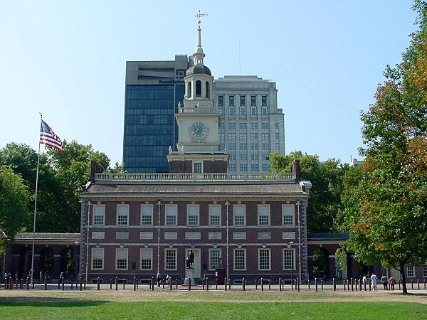
In 1787, the country’s founding fathers
decided to meet in Independence Hall in
Philadelphia to rewrite the Article of Confederation.

Slide 10
The delegates met here in secret as they wrote the Constitution. The American public will not know what happened here until James Madison publishes his autobiography many years later.
George Washington sat here

Slide 11
George Washington
James Madison
Alexander Hamilton
Ben Franklin

Slide 12
Debate over the various plans presented at the Constitutional Convention resulted in the Connecticut (Great) Compromise.
This compromise settled the disputes between the states over the structure of the legislative branch.
Congress would be a bicameral legislature, with representation in the lower house based on the population of the state and equal representation of the states in the upper house.

Slide 13
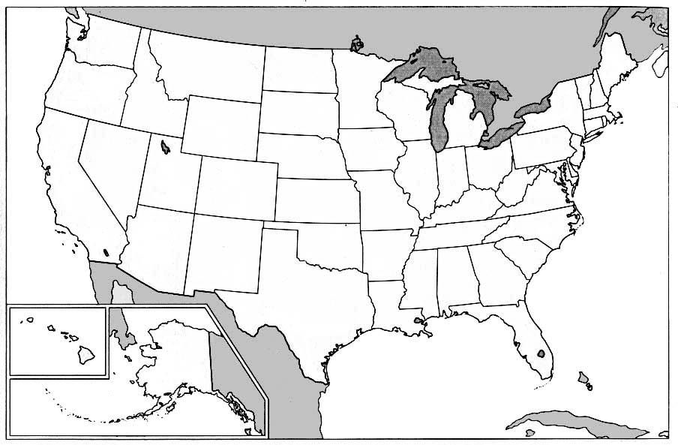
How should states be represented in Congress?
An equal number of representatives for each state?
Or divided in proportion to population?
TEXAS
32 representatives
ranked 2nd in population
20,851,820 persons
NEW HAMPSHIRE
2 representatives
ranked 41st in population
1,235,786 persons

Slide 14
Every state is equally represented in the Senate.
TEXAS:
Two
Senators
NEW
HAMPSHIRE:
Two
Senators

Slide 15
In the House of Representatives the larger states get more members because of their population. They serve 2 year terms. The President also gives the State of the Union address here.
President

Slide 16
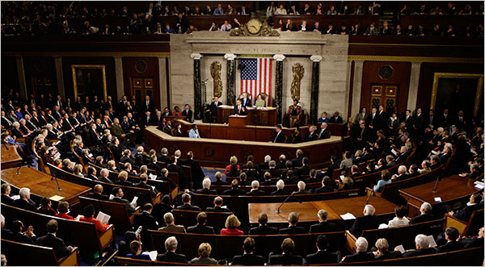
Barack Obama

Slide 17
In the U.S. Senate, each state gets two representatives who serve 6 year terms. This made the smaller states happy.

Slide 18
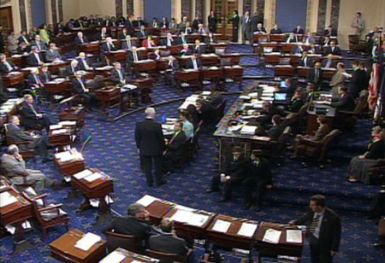

Slide 19
The House of Representatives + The Senate = Congress. These are the people who make the laws. Today Congress is housed in the U.S. Capital building in Washington D.C.

Slide 20
A second compromise concerned the counting of slaves for the purpose of determining population for representation in Congress and for taxation.
Southern states wanted slaves to be counted for representation but not for taxation.
Northern states wanted slaves counted for taxation but not for representation.
The Three-Fifths Compromise resolved this issue: each state would count three-fifths of its slave population for purposes of determining both representation and taxation.

Slide 21
The Commerce and Slave Trade Compromise resolved other differences between southern and northern states.
Congress was prohibited from taxing exports from the states and from banning the slave trade for a period of 20 years.
Numerous other compromises were made at the constitutional Convention concerning the executive and judicial branches as well as the electoral process for choosing a chief executive.

Slide 22
Ratification of the Constitution
Although the delegates at the convention signed the Constitution on September 17, 1787, it still had to be ratified by 9 of the 13 states before it could go into effect.
In each state, special ratifying conventions would be held over the next two years. Debate over ratification divided citizens into Federalist and Anti-Federalist positions.
The Federalists stressed the weaknesses of the Articles of Confederation and the government it created. They supported a stronger central government with expanded legislative powers.

Slide 23
The Federalist cause was helped by James Madison, Alexander Hamilton, and John Jay in a collection of 85 essays published in the New York newspapers under the name “Publius.” (Hamilton wrote 51, Madison wrote 26, Jay wrote 5, and Hamilton and Madison co-created 3 of these essays.)
These Federalist Papers defended the new government created under the constitution and even today provide insight into the framers’ original intent.
The Anti-Federalists believed that the new Constitution gave too much power to the national government at the expense of the state governments.
Another objection was the lack of a Bill of Rights, ensuring fundamental liberties.

Slide 24
James Madison got the nickname “The Father of the Constitution” at this convention. Many of his ideas will be written into the new government. He will eventually become the 4th President of the United States

Slide 25
Alexander Hamilton

Slide 26
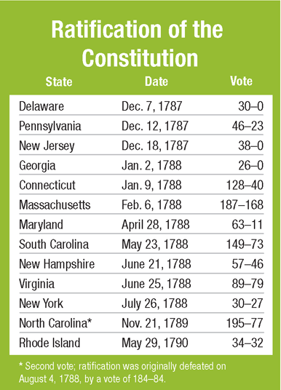
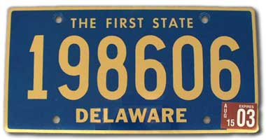

Slide 27
The United States Constitution
A constitution details the structure of a government. The Constitution of the United States is the oldest national constitution in use today. Although the Constitution is relatively short, it describes the structure and powers of the national government as well as the relationship between the national and state governments.

Slide 29
Basic Principles Within the Constitution
Embodied within the Constitution are the basic principles of:
Limited government—belief that government is not all-powerful; government has only those powers given to it
Popular sovereignty—the people are the source of government’s authority
Separation of powers—power is separated among three branches of government; each has its own powers and duties and is independent of and equal to the other branches
Checks and balances—each branch is subject to restraints by the other two branches
Federalism—a division of governmental powers between the national government and the states

Slide 30
Formal Amendment Process
One major weakness of the Articles of Confederation was the amendment process, which required unanimous approval for amendments to become effective. The framers of the Constitution anticipated the need to change the Constitution and provided a process to amend the Constitution (Article V) that required both state and national action.
Amending the Constitution requires proposal, a national function, and ratification, a state function. Amendments may be proposed in Congress by two methods and ratified by two methods, creating four possible methods for formally amending the Constitution.

Slide 31
Proposed by two-thirds vote of each house of Congress and ratified by three-quarters of the state legislatures (used 26 times)
Proposed by two-thirds vote of each house of Congress and ratified by special conventions in at least three-quarters of the states (used once, to ratify the Twenty-First Amendment)
Proposed by a national convention called by Congress at the request of two-thirds of the state legislatures and ratified by three-quarters of the state legislatures (never used)
Proposed by a national convention called by Congress at the last request of two-thirds of the state legislatures and ratified by special conventions in at least three-quarters of the states (never used)

Slide 33
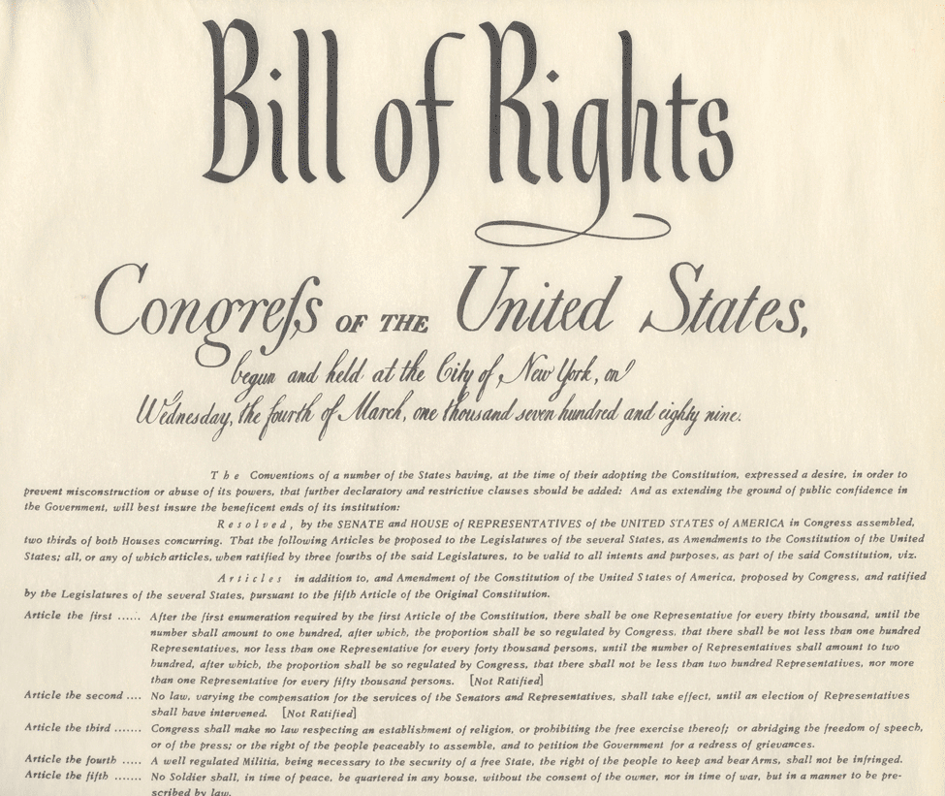

Slide 34
1st Amendment – freedom of speech, of the press, and of assembly; right to petition, freedom of Religion.
2nd Amendment – Right to Bear Arms (own weapons).
3rd Amendment – No quartering of troops.
4th Amendment – Protection from unreasonable search and seizure.
5th Amendment – Protection from double jeopardy, and self incrimination (“I plead the 5th”).
6th Amendment – Right to a speedy and public trial.
7th Amendment – Right to a trial by jury.
8th Amendment – Protection from excessive bail and cruel and unusual punishment.
9th Amendment – Protection from rights not specifically written in the constitution.
10th Amendment – Power not given to the federal government will be given to the states.

Slide 36
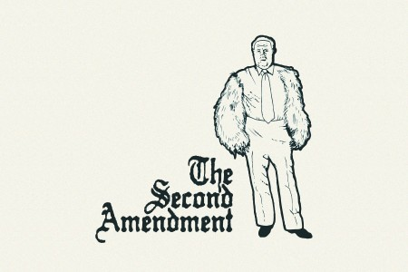

Slide 37
Formal Amendments
Formal amendments are written changes to the Constitution. They add to, change the wording of, or delete language from the Constitution. Only 27 formal amendments have been added to the Constitution since its adoption. The first 10 amendments, the Bill of Rights, were added in 1791.
Informal Amendment Process
Although the United States Constitution has been formally changed only 27 times, there have been many changes in the way in which the American government operates. Most of those changes have come about through the informal amendment process and do not involve actually changing the wording of the Constitution. Informal changes in the Constitution may occur in the following ways:

Slide 38
Legislative actions—Congress has passed various acts that have altered or made clear the meaning of the Constitution. For example, under Article III Congress is given the authority to create lower courts, which they did through the Judiciary Act of 1789.
Executive actions—The manner in which presidents use their powers can create informal amendments and expand presidential authority. The use of executive agreements rather than treaties allows the president to bypass the Senate.

Slide 39
Judicial interpretation/judicial review—The people who serve as judges and the times in which they serve affect how courts interpret laws. The concept of judicial review resulted from Marbury v. Madison (1803); it is not mentioned in the Constitution.
Custom and usage—Traditions that have been incorporated into the political system and which have lasted over time have changed the meaning of the Constitution. Senatorial courtesy in the Senate and the “no-third-term” tradition in the Presidency (until the Twenty-Second Amendment made it part of the Constitution) are examples.

Slide 40
Marbury v. Madison (1803)
In the election of 1800 political parties played an active role. Federalists supported John Adams, and Democratic-Republicans supported Thomas Jefferson. At the conclusion of the election, Adams and the Federalists had lost control of the presidency and Congress.
In an effort to retain some control in the government, the “lame duck” Federalist Congress created numerous new judicial positions (judges), which outgoing President Adams attempted to fill. Late into the night prior to Jefferson’s inauguration, Adams was still signing the commissions of the “midnight appointments” which the secretary of the state was to deliver.

Slide 41
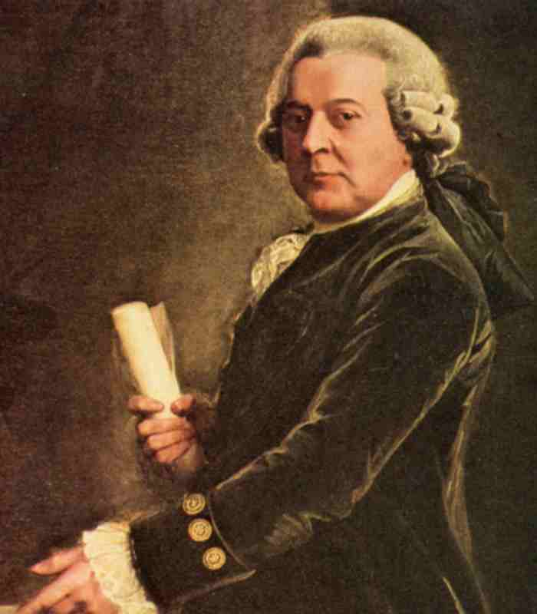
2nd President John Adams 1797-1801 Federalist

Slide 42
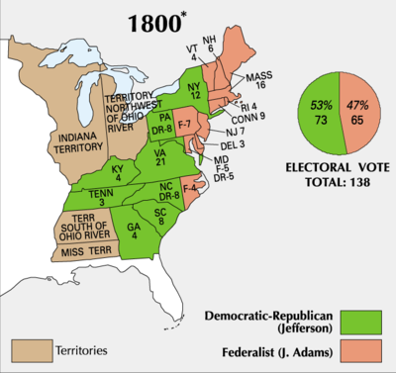

Slide 43
3rd President Thomas Jefferson 1801-1809 Democratic-Republican

Slide 44
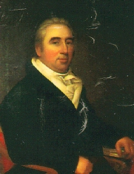
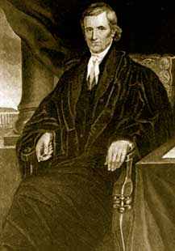
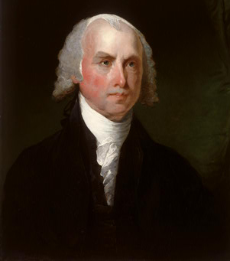
Judicial review was established in 1803 with the case of Marbury v. Madison, a case brought before the Supreme Court with Chief Justice John Marshall presiding.
Chief Justice
John Marshall
William Marbury
James Madison

Slide 45
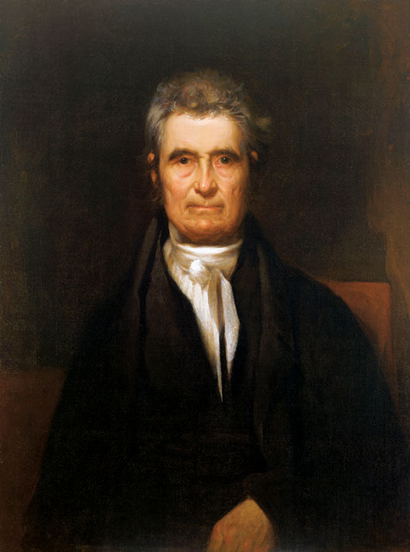
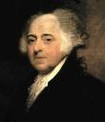
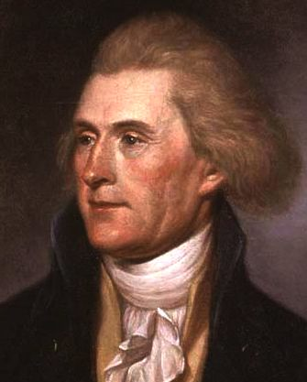
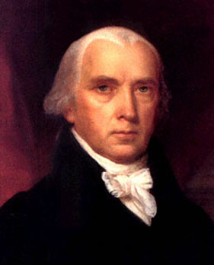
Marbury v. Madison: The Problem
Outgoing president John Adams, a Federalist, appointed William Marbury as justice of the peace in the District of Columbia.
His commission papers had not been delivered by the time incoming Democratic-Republican president Thomas Jefferson took office.
The new secretary of state, James Madison, refused to deliver Marbury’s commission papers.
Marbury invoked the original jurisdiction of the United States Supreme Court, asking that the Court issue a writ of mandamus to Madison, ordering him to deliver the commission.
Adams
Jefferson
Marbury
Madison
Marshall

Slide 46
Not all the commissions were delivered, and when Jefferson took office, he ordered the commissions withheld, intending to make his own appointments. John Marbury expected to receive a commission as a justice of the peace for the District of Columbia. He petitioned the Supreme Court to issue a writ of mandamus (allowed under the Judiciary Act of 1791) ordering Secretary of State James Madison to deliver the commission to Marbury and several others.

Slide 47
The Supreme Court under Chief Justice John Marshall ruled that although Marbury was entitled to the commission, the Supreme Court would not order Madison to give it to him because the court did not have authority under the Constitution to decide this type of case, and that portion of the Judiciary Act of 1791 that allowed the Court to hear these cases was unconstitutional. This case established the principle of judicial review and was the first time the court declared an act of Congress unconstitutional.

Slide 48
John Marshall

Slide 49
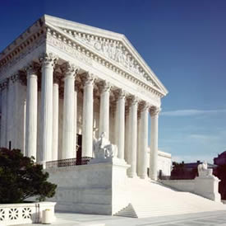
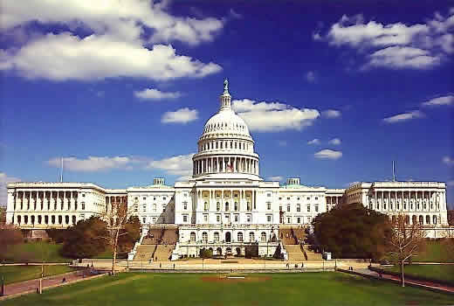
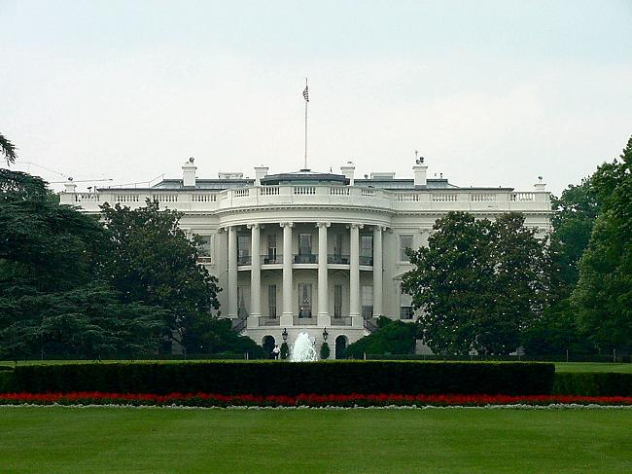
Judicial review is the right of United States federal courts to determine the constitutionality of laws passed by Congress and acts of the executive branch.
As final authority, the Supreme Court has the right to review any decision of a lower court, act of Congress, state law, or decision by an administrative agency to determine its constitutionality.
Conversely, the Congress has the right to propose new constitutional amendments. Also, the executive branch may choose not to enforce a Court decision.

Slide 50
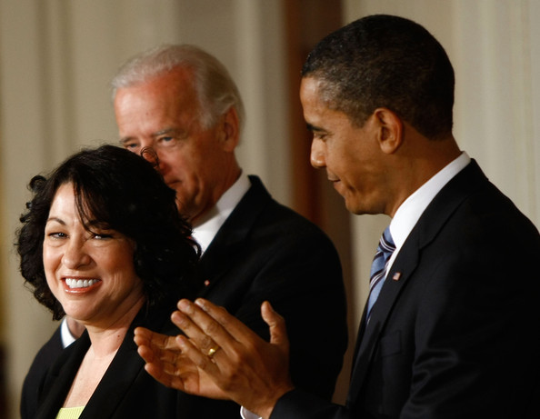
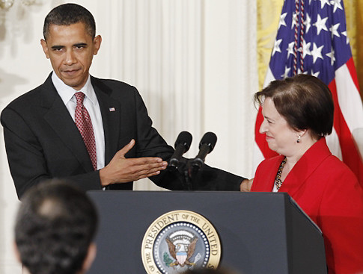
President Obama nominated two women for the Supreme Court. Sonia Sotomayor, and Elena Kagan. Both have been confirmed by the U.S. Senate.

Slide 51
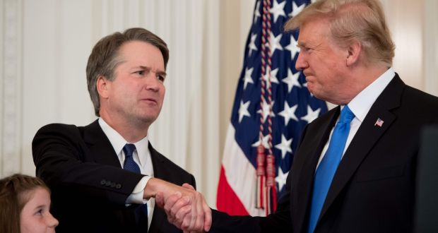
So far, President Trump nominated two justices of the Supreme Court. Neil Gorsuch and Brett Kavanaugh. Both have been confirmed by the U.S. Senate.

Slide 52
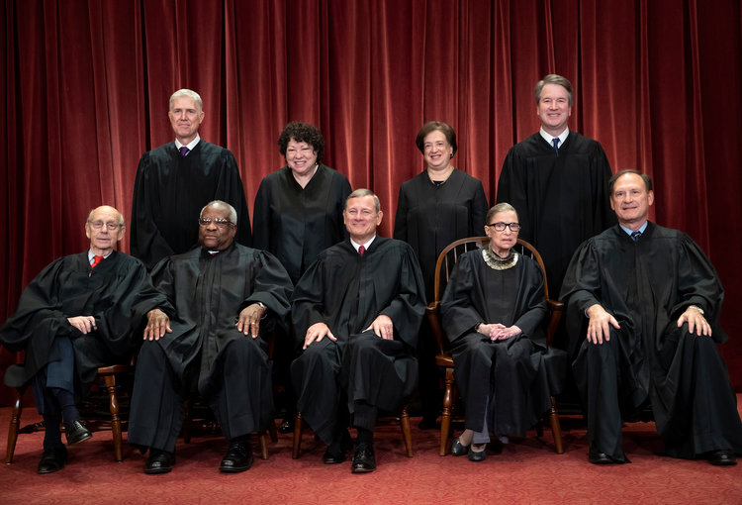
Supreme Court 2019

Slide 53
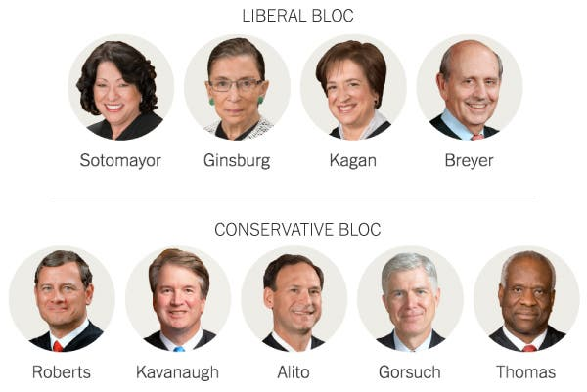

Slide 54
"It is, emphatically, the province and duty of the judicial department, to say what the law is…. So, if a law be in opposition to the constitution; if both the law and the constitution apply to a particular case, so that the court must either decide that case, conformable to the law, disregarding the constitution; or conformable to the constitution, disregarding the law; the court must determine which of these conflicting rules governs the case; this is of the very essence of judicial duty. If then, the courts are to regard the constitution, and the constitution is superior to any ordinary act of the legislature, the constitution, and not such ordinary act, must govern the case to which both apply."
Chief Justice John Marshall

Slide 55
