Slide 1
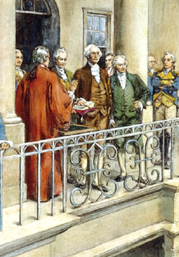
Lesson 23:
What Is the Role of the President in the American Constitutional System?

Slide 2
Purpose
The president is among the most powerful political figures in the world.
Internationally, the president speaks for the country and is the symbol of America.
Domestically, the president suggests policies to Congress and is the leader of their political party.
Americans look to the president for leadership, while also fearing concentration of executive power.
This lesson examines sources of presidential power and ways that checks and balances limit presidential power.

Slide 3
Terms to Know
commander in chief Highest ranked person of the military forces. According to the U.S. Constitution, the president is commander in chief of the nation's armed forces. executive orders Directives issued by the president, including Presidential Directives, National Security Directives, and Homeland Security Presidential Directives. Presidents have issued such orders since 1789. Such orders are open to the public, except for National Security Directives. executive power The authority to carry out and enforce the law.

Slide 4
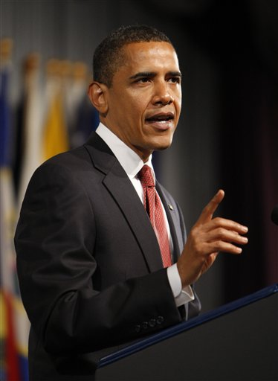
The President’s Responsibilities
Executive Power not specifically defined in Constitution, but following powers are listed (Art. II)
Commander in Chief of army and navy
Heads executive department
Granting reprieves and pardons
Making treaties (subject to Senate’s
consent)
Nominating ambassadors, consuls, judges
Recommend legislation to Congress
Review legislation/Veto bills
Receive ambassadors (chief diplomat)
“Take Care that laws are carefully executed”
Preserve, protect, and defend the Constitution

Slide 5
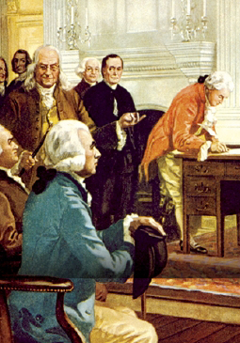
The Framers’ Vision of the Presidency
Official above partisan politics
Electoral College would identify people with character “preeminent for ability and virtue”
No expectation of campaigns
Wanted “energetic” president as opposed to legislature’s “deliberative” nature (Congress)
Hamilton: “Bad execution… must be… a bad government.” No feeble President!

Slide 6
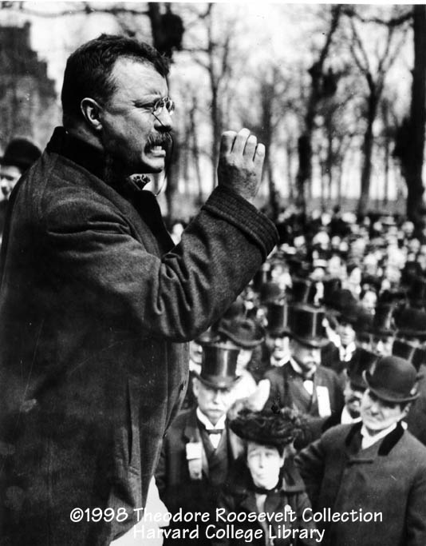
The Presidency Evolves
Andrew Jackson
Unprecedented use of veto (national bank)
Abraham Lincoln
Expansion of wartime powers “Inherent
Executive Powers” (suspension of habeas corpus)
Teddy Roosevelt
“Bully Pulpit” – used visibility and influence of presidency to advocate his political agenda

Slide 7
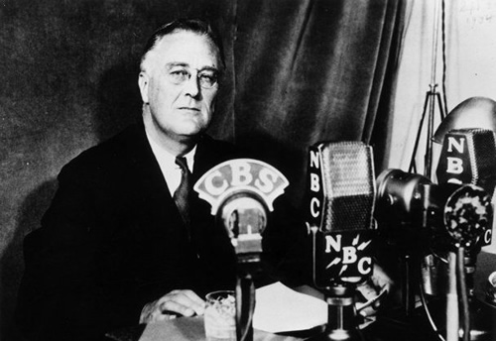
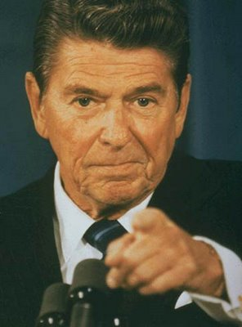
The Presidency Evolves
FDR
Took control of policy process through New Deal programs.
Social Security, employment programs, executive agency reform
Exerted unprecedented military power during WWII
Employed “fireside chats” to establish trust and confidence
*Public Opinion polls
Since FDR
Effective presidents have used FDR’s strategies to bolster power
Reagan – “The Great Communicator”
JFK & Clinton – Used charisma to win political allies and persuade public to support policy proposals

Slide 8
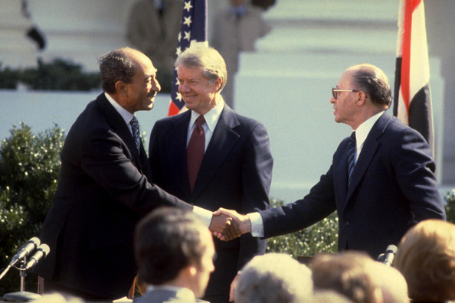
Foreign Policy
Congress’s role (declare war, fund armed forces…) largely reactionary to president
The President foreign relations powers…
Commanding Armed Forces
Military power used to defend nation and as a threat to persuade
Each president since FDR has sent troops abroad w/o declaration of war.
Making Treaties
Sole authority to negotiate
on behalf of US, pending 2/3
Senate approval

Slide 9
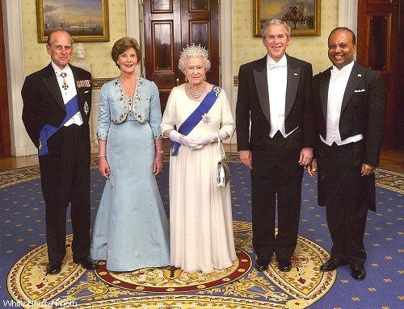
Foreign Policy
Appointing Ambassadors & Public Ministers
President decides who represents US abroad. (majority vote of Senate)
Ambassadors help shape US image and advise on foreign policy as well as monetary and foreign aid
Receiving Ambassadors and Other Public Ministers
President sole channel of international communications
Assumes right not to recognize them
DESTROY A GOV’T

Slide 10
Expansion of War Powers
During wars and emergencies, presidents often exercise power not granted in Constitution
Grover Cleveland – sent unauthorized troops to put down Pullman train car strike
FDR – sent war ships to Britain before entered WWII
Attempts at restraint
1952 – Supreme Court rules against Truman (seizing steel mills during Korean War)
2006 – Bush’s “special military commissions” violated US law and Geneva Convention
However, Congress & Court tend to defer to president

Slide 11
Expansion of Presidential Power
Over time, power has flowed from one branch to the other.
19th C. – Congress dominated
20th C. – As role of US in world grew, so did Executive power
Why growth of presidential power?
Over past century, polls show public demand for strong president
However, polls also show public distrust of strong executives
Broad constitutional powers and can be interpreted differently
Role in recommending legislation
Increasingly active role in development of federal regulations
Regulations elaborate on general laws passed by Congress

Slide 12
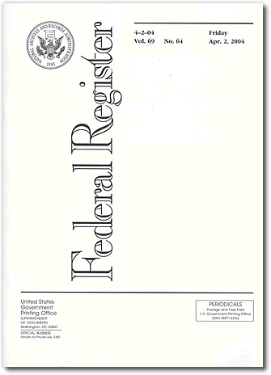
Expansion of Presidential Power
Executive Orders
Rule or regulation issued by the president.
*Fills in the details of NEW LAWS
Must be published in Federal Register
Assumption of new responsibilities
Issues involving education, health care, transportation, product safety, etc. have shifted from purely state / local control to national as well.

Slide 13
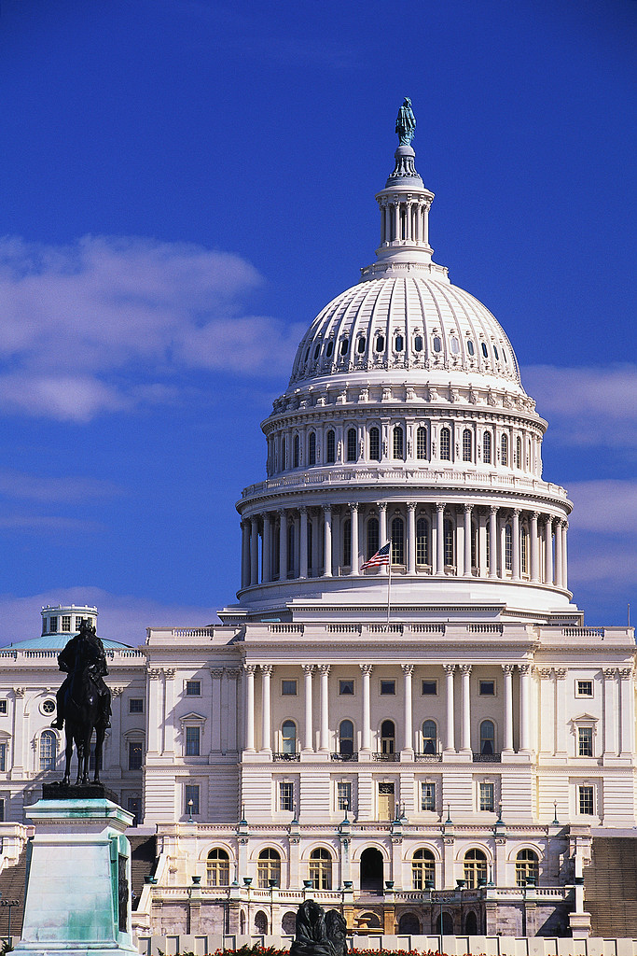
Limitations on Power
Congress
Rejecting or modifying president’s legislative agenda
Asserting its constitutional authority
(war powers)
Refusing to ratify treaties
Refusing to confirm nominees
Refusing to fund programs
Removing president from office

Slide 14
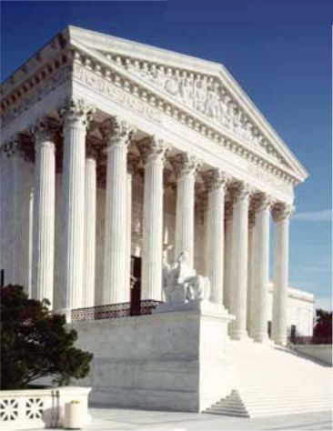
Limitations on Power
Supreme Court
Humphrey’s Executor v. US (1935)
Congress must approve president’s removal of official from independent regulatory agencies
US v. Nixon (1974)
President not entitled to automatic immunity from legal process
Train v. City of NY (1975)
President cannot refuse to spend money appropriated by Congress
Executive Agencies
Public Opinion
*Lack of public support leave President HANDCUFFED

Slide 15
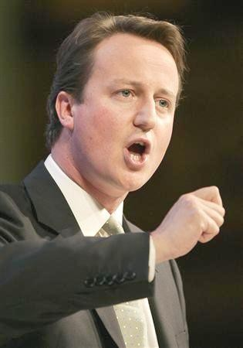
Differences Between American Presidency & British Prime Minister
Prime Minister
Chief Executive
Appointed by majority party or coalition
Must have served in Parliament
Passage of legislation more efficient, but PM can be quickly replaced once they lose confidence of Parliament

Slide 16
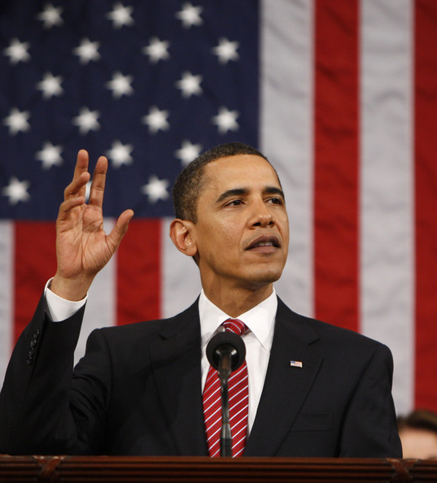
Differences Between American Presidency & British Prime Minister
Presidency
Not appointed, elected. No experience required.
Fixed 4-yr term, regardless of public opinion
Many more checks on power than in Parliamentary system
Power depends on ability to persuade
President’s standing in eyes of world can enhance or detract from international reputation of nation.

Slide 17
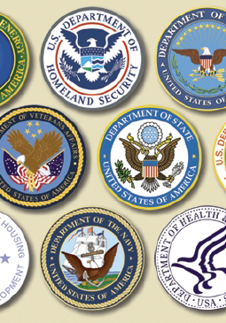
Lesson 24:
How Are National Laws Administered in the American Constitutional System?

Slide 18
Purpose
Departments, agencies, and bureaus that administer laws (bureaucracy) touch every aspect of American life.
This lesson examines the role of administrative departments and agencies in America’s national government.

Slide 19
Objectives
Explain why Congress create administrative units, the circumstances that contribute to their creation, and the range of governmental functions that administrative perform.
Identify some of the checks on the exercise of administrative power.
Evaluate, take and defend positions on public administration in the United States.

Slide 20
Terms to Know
bureaucracy Governmental departments and agencies and their staffs, principally civil service members and political appointees. cabinet The group of advisors to the president composed of the heads of the departments of the executive branch and certain other officials. Cabinet advice to U.S. presidents is not binding, as opposed to parliamentary systems, where the consensus of cabinets is said to bind prime ministers. civil service Employment in federal, state or provincial, and local governmental agencies. The civil service was formed in an effort to reduce political patronage and promote professionalism in government. independent agencies Administrative organizations located outside the structure of executive departments.

Slide 21
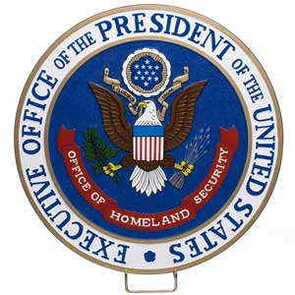
Kinds of Administrative Units
Executive Departments
Congress directs each to administer certain laws / President appoints each secretary, or “head” (Cabinet)
Currently 15 departments, each head in line of succession
Executive Office of the President (EOP)
Created in 1939 to help with budgeting, personell management, and natural resources planning.
Includes: White House Office, Office of
Management & Budget, Council of
Economic Advisors, National Security
Council

Slide 22
Kinds of Administrative Units
Independent Agencies
Located outside structure of Executive Departments
Granted quasi-legislative regulatory powers
Ex) Environmental Protection Agency (EPA), Peace
Corps
Others
Federal Emergency Management Association (FEMA)
Was independent agency, now part of Dept. of Homeland Security
US Postal Service
Government corporation
Federal Communications Commission (FCC)
Designed to enforce regulations of the industry

Slide 23
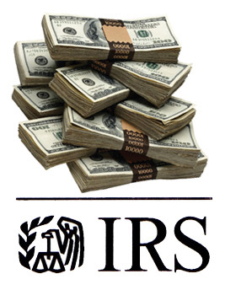
Administrative Organizations
Quasi-legislative powers delegated to implement broad congressional mandates.
Rules published in Federal Register
Some units granted quasi-judicial powers
Hearings held to resolve disputes
Example: IRS
Makes & Enforces rules about tax collections. Also holds hearings for those accused of violations.
Administrative Procedure Act (1946)
Established rules to implement laws, requires public notice / hearings, permits judicial review of administrative decisions

Slide 24
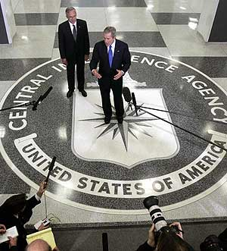
Contributing Factors
Growth in response to demands placed on gov’t
Ex) Industrial Revolution lead to Dept. of Commerce and Labor, Interstate Commerce Commission, and Federal Trade Commission
Great Depression / New Deal
FDR creates significant growth in federal bureaucracy in response to national crises
Cold War
Dept. of Defense, National Security Council,
CIA…

Slide 25
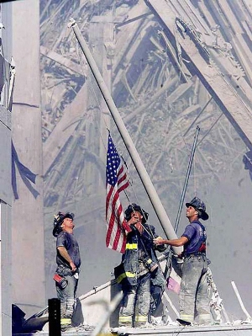
Contributing Factors
Reduction
Starting in 1970s, many commissions and boards abolished
Ex) Interstate Commerce Commission
9/11
Terrorist attacks result in creation of Department of Homeland Security

Slide 26
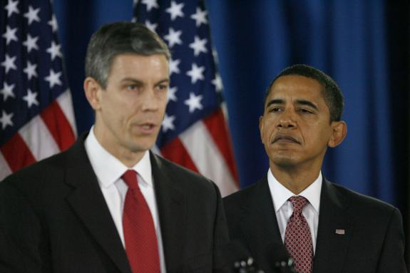
Staffing Administrative Agencies
Civil Service
1883 – Patronage substituted for merit-based system / administrative class insulated from politics
Congress sill establishes office requirements, performance standards, wages, benefits, & “whistle-blower” protections
Hatch Act (1939)
Parties prohibited from pressuring workers to contribute or work for candidates in exchange for job security
President makes appointments to
key leadership positions
Helps ensure bureaucracy enacts his
policy agenda
With new administration’s usually
complete change in leadership

Slide 27
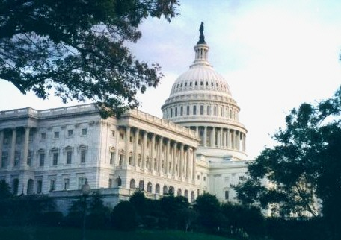
Checks & Balances
The President
Appointment power rewards loyalists / advances agenda
Executive Orders – directs agencies to take certain actions
Congress
Creates, consolidates, or eliminates agencies
Senate confirms high-level appointees
Statutes direct agency actions
Appropriates funding
Congressional Oversight
Ex) review budgets, investigate actions

Slide 28
Checks & Balances
Courts
Decide whether agencies violate 14th Amendment due process & equal protection requirements
Requires Congress to clearly define agency standards
Federalism
If state and national policies differ, states sometimes resist or refuse to comply with standards (ex. Education reform)
Citizens, Interest Groups, Media
Those directly affected by public policy ca monitor actions, report complaints, or investigate issues regarding problems and injustice in the bureaucracy

