Slide 1
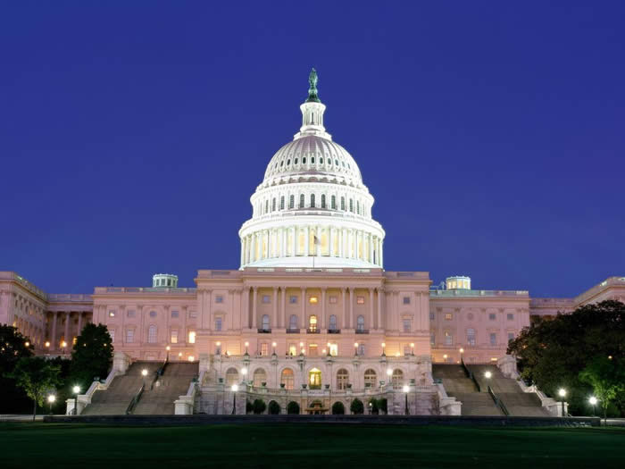
7. The Legislative Branch

Slide 2
Summary
Summary: Article l of the United States Constitution creates a bicameral, or two-house, legislature consisting of the House of Representatives and the Senate. The current structure of the Congress was the result of the Connecticut (Great) Compromise, reached at the Constitutional Convention. The founding fathers based their compromise in part on the belief that each house would serve as a check on the power of the other house. The House of Representatives was to be based on the population in the states, representative of the people, with its members chosen by popular voice. The Senate was to represent the states, with each state having the same number of senators, chosen by the state legislatures.

Slide 3
Why are there two houses of Congress?
Pennsylvania, Georgia and Vermont were unicameral.
The other states, like the British Parliament, were bicameral.
At the Constitutional Convention, seven states voted in favor of a bicameral congress, three voted for a unicameral congress, one state abstained and one was undecided.
Unicameral: one house
Bicameral: two houses

Slide 4
Structure of Congress
 | House of Representatives | Senate
Membership | 435 members (apportioned by population) | 100 members (two from each state)
Term of Office | 2 years; entire House elected every 2 years | 6 years; staggered terms with one-third of the Senate elected every 2 years
Qualifications | At least 25 years of age; citizen for 7 years; must live in state where district is located | At least 30 years of age citizen for 9 years must live in state
Constituencies | Smaller, by districts | Larger, entire state
Prestige | Less prestige | More prestige

Slide 5
Organization of Congress
Two houses meet for terms of two years beginning on January 3 of odd-numbered years; each term is divided into two one-year sessions
The president may call special sessions in cases of national emergency
Each house of Congress chooses its own leadership and determines its own rules

Slide 6
Congress is the bicameral (two-house) legislature responsible for writing the laws of the nation. Congress also serves other functions, such as overseeing the bureaucracy, consensus building, clarifying policy, legitimizing, and expressing diversity. It is made up of a House of Representatives with 435 members and a Senate of 100 members.

Slide 7
The U.S. Constitution mandates that House Representatives represent single-member districts with approximately equal numbers of constituents.
Every ten years a census is taken by the federal government to count the population to determine the number of each state’s congressional districts. Each state must then redraw its congressional boundaries to ensure that each district is equal in population.

Slide 8
Congressional Reapportionment is done by each state’s legislature. Therefore, the political party in control of the state legislature is responsible for redrawing Congressional District boundaries. As much as is legally possible, the legislature will gerrymander the district boundaries to give the majority party an advantage in future elections.

Slide 9
This is true in every state except Iowa, which uses an independent commission to redraw Congressional District boundaries. In some states, such as Alaska and Wyoming, the populations are so small that the entire state becomes a congressional district; all states are guaranteed at least one seat in the House.

Slide 10
Election to Congress
Getting Elected to the House of Representatives
The constitution guarantees each state at least one representative. Members are chosen from districts within each state. Some practices related to determining congressional representation are:
Apportionment – distribution among the states based on the population of each of the states
Reapportionment – the redistribution of Congressional seats after the census determines changes in population distribution among the states
Congressional districting – the drawing by state legislatures of congressional districts for those states with more than one representative
Gerrymandering – drawing congressional districts to favor one political party or group over another

Slide 11
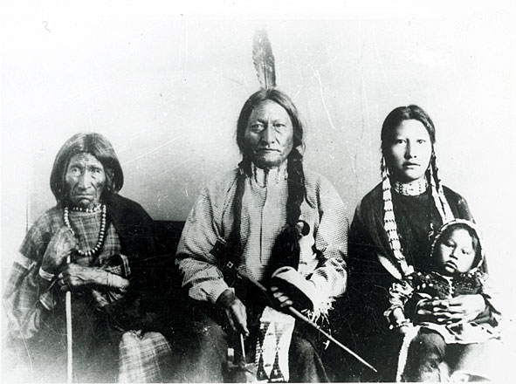
The Constitutional Convention decided that the House of Representatives would be elected by proportion of free citizens and 3/5 for slaves, with no representation for Indians not paying taxes.
The Constitution stated that the number of representatives "shall not exceed one for every thirty thousand." Later, this number was modified to reflect population growth.
In 1789, there were 59 representatives.
In 1911, the total number of representatives was fixed at 435.
Today, each House member represents about 693,000 persons.

Slide 12
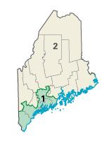
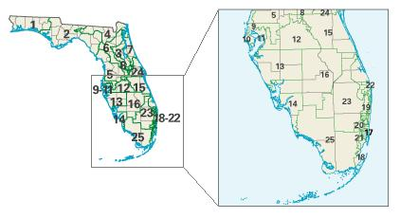
Congressional Districts
The number of House members representing each state depends upon the state’s population as reported in the U.S. Census.
The census is taken every ten years, as directed by the Constitution.
Each state is divided into congressional districts of equal population. Every state has at least one congressional district.
There is one representative for each congressional district.
Rhode Island and Maine have two districts each.
Florida has 27 districts.

Slide 13
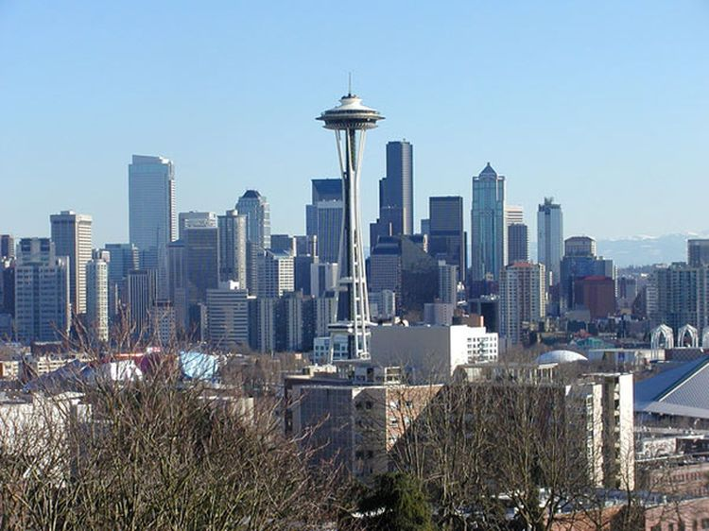
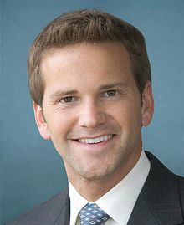
Qualifications for the House of Representatives
In order to be elected to the House of Representatives, one must be:
A citizen of the U.S. for at least seven years.
At least 25 years old.
Aaron Schock (R) Illinois 31 years old
A resident of the state being represented.

Slide 14
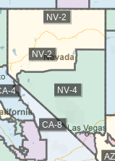
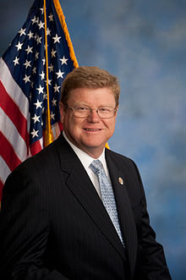
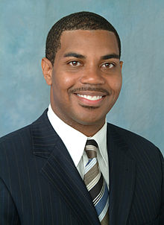
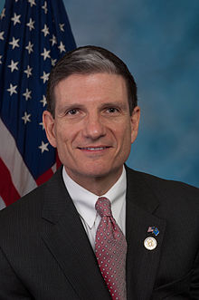
Mark E. Amodei(R)
District 2
Steven Horsford (D)
District 4
Joe Heck (R)
District 3

Slide 15
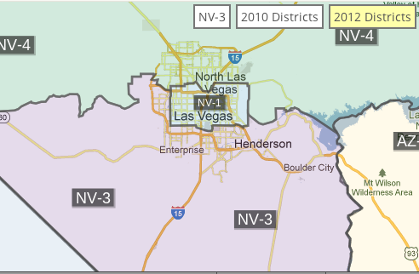
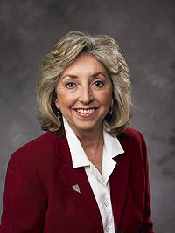
Dina Titus (D) District 1

Slide 17
Getting Elected to the Senate
The Constitution guarantees that “no state without its consent shall be deprived of its equal suffrage in the Senate” (Article V).
Members were originally chosen by the state legislatures in each state.
Since 1913, the Seventeenth Amendment allows for the direct election of senators by the people of the state.

Slide 18
The Senate Was Appointed
Originally senators were appointed by the state legislatures. The Constitution’s framers believed that since the senators represented their states, the state legislatures should elect them.
The Senate of the United States shall be composed of two Senators from each State, chosen by the Legislature thereof, for six Years.
-U.S. Constitution, Article I, Section 3, Clause 1
Senators represent entire states.

Slide 19
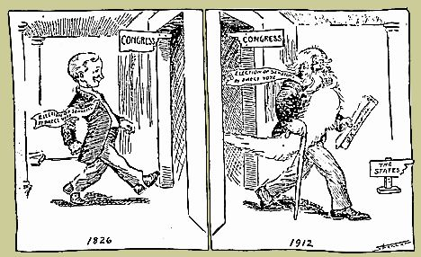
The 17th Amendment: Popular Election of Senators
"The Senate of the United States shall be composed of two Senators from each State, elected by the people thereof, for six years; and each Senator shall have one vote."
The 17th Amendment, ratified April 8, 1913, also provides that the governor, with the permission of the state legislature, may fill a senate vacancy by appointment.
Cartoon portraying the time it took Congress to pass the 17th Amendment allowing the direct election of U.S. senators.

Slide 20
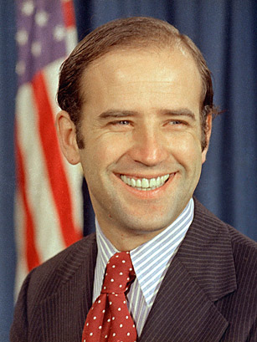
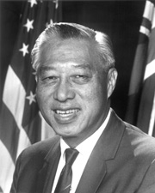
Requirements for United States Senators
Senators must be at least 30 years old upon taking office.
They must have been U.S. citizens for at least nine years.
They must be residents of the states that they represent.
Senator Rush D. Holt of West Virginia was America’s youngest elected senator. He was 29 when elected and had to wait six months to be sworn into office.
Senator Joseph Biden is America’s second youngest elected senator. He was 30 years old when he was elected.
Hiram Fong was the country’s first Asian American senator, elected to the Senate in 1959 upon the admission of Hawaii as a state.

Slide 21
Senators serve six-year terms. One-third of the Senate comes up for election every two years.
Immediately after they shall be assembled in Consequence of the first Election, they shall be divided as equally as may be into three Classes.
—U.S. Constitution, Article I, Section 3, Clause 2
1
2
3
4
5
6
1
2
3
4
5
6
1
2
3
4
5
6
The three Senate classes overlap by two years, so that one-third of the Senate is always subject to change.

Slide 22
Incumbency Effect
The incumbency effect is the tendency of those already holding office to win reelection. The effect tends to be stronger for members of the House of Representatives and weaker for the Senate. Advantages may include:

Slide 23
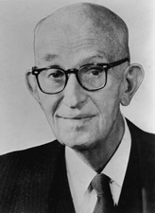
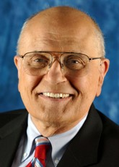
Incumbents
Carl T. Hayden of Arizona served 8 terms in the House and 7 terms in the Senate, totaling almost 57 years. He died in 1972.
An incumbent is a member of Congress running for re-election.
95% of House incumbents win.
A congressional sophomore is a representative in his or her second term of office.
The term sophomore surge refers to the 8 to 10% increase in votes usually received by an incumbent running for a second term.
The "dean" of the House of Representatives is the longest-serving (in consecutive terms) member. The present dean is John Dingell of Michigan. He has served since 1955.

Slide 24
Name recognition – voters are more likely to recognize the officeholder than the challenger.
Credit claiming – the officeholder may have brought government projects and money into the state or district.
Casework for constituents – Officeholders may have helped constituents solve problems involving government and the bureaucracy.
More visible to constituents – Members can use the “perks” of the office to communicate with constituents. Franking, the privilege of sending official mail using the incumbent’s signature as postage, provides communication with constituents.

Slide 25
Media exposure – Incumbents are more likely to gain “free” publicity during a campaign through the media.
Fundraising abilities – it is generally greater for incumbents.
Experience its campaigning – incumbents have already experienced the campaign process.
Voting record – Votes can evaluate their performance based on their record.

Slide 26
Term Limits
Although several states have passed legislation establishing term limits for members of Congress, the Supreme Court has ruled that neither the states nor Congress may impose term limits without a constitutional amendment. Therefore, today, there are no limitations on the number of terms a member of Congress may serve.

Slide 27
Leadership of Congress
The majority political party in each house controls the leadership positions of Congress.
House of Representatives
The Speaker of the House is the presiding officer and most powerful member of the House. Major duties include assigning bills to committee, controlling floor debate, and appointing party members to committees.

Slide 28
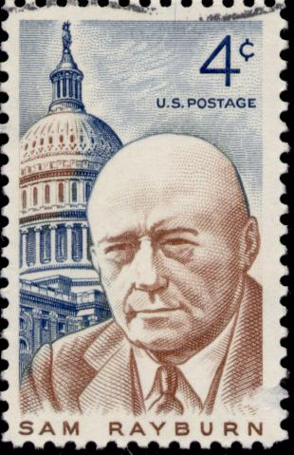
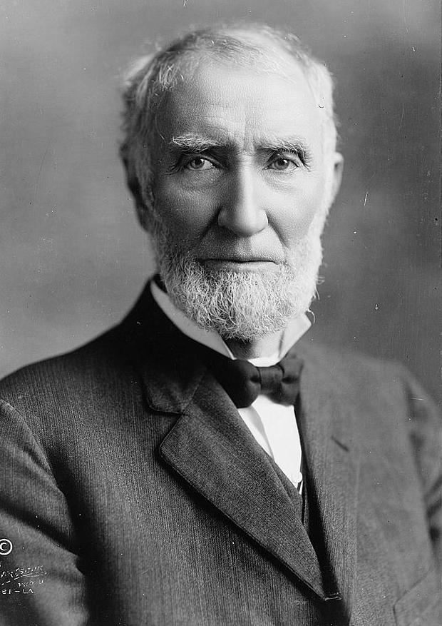
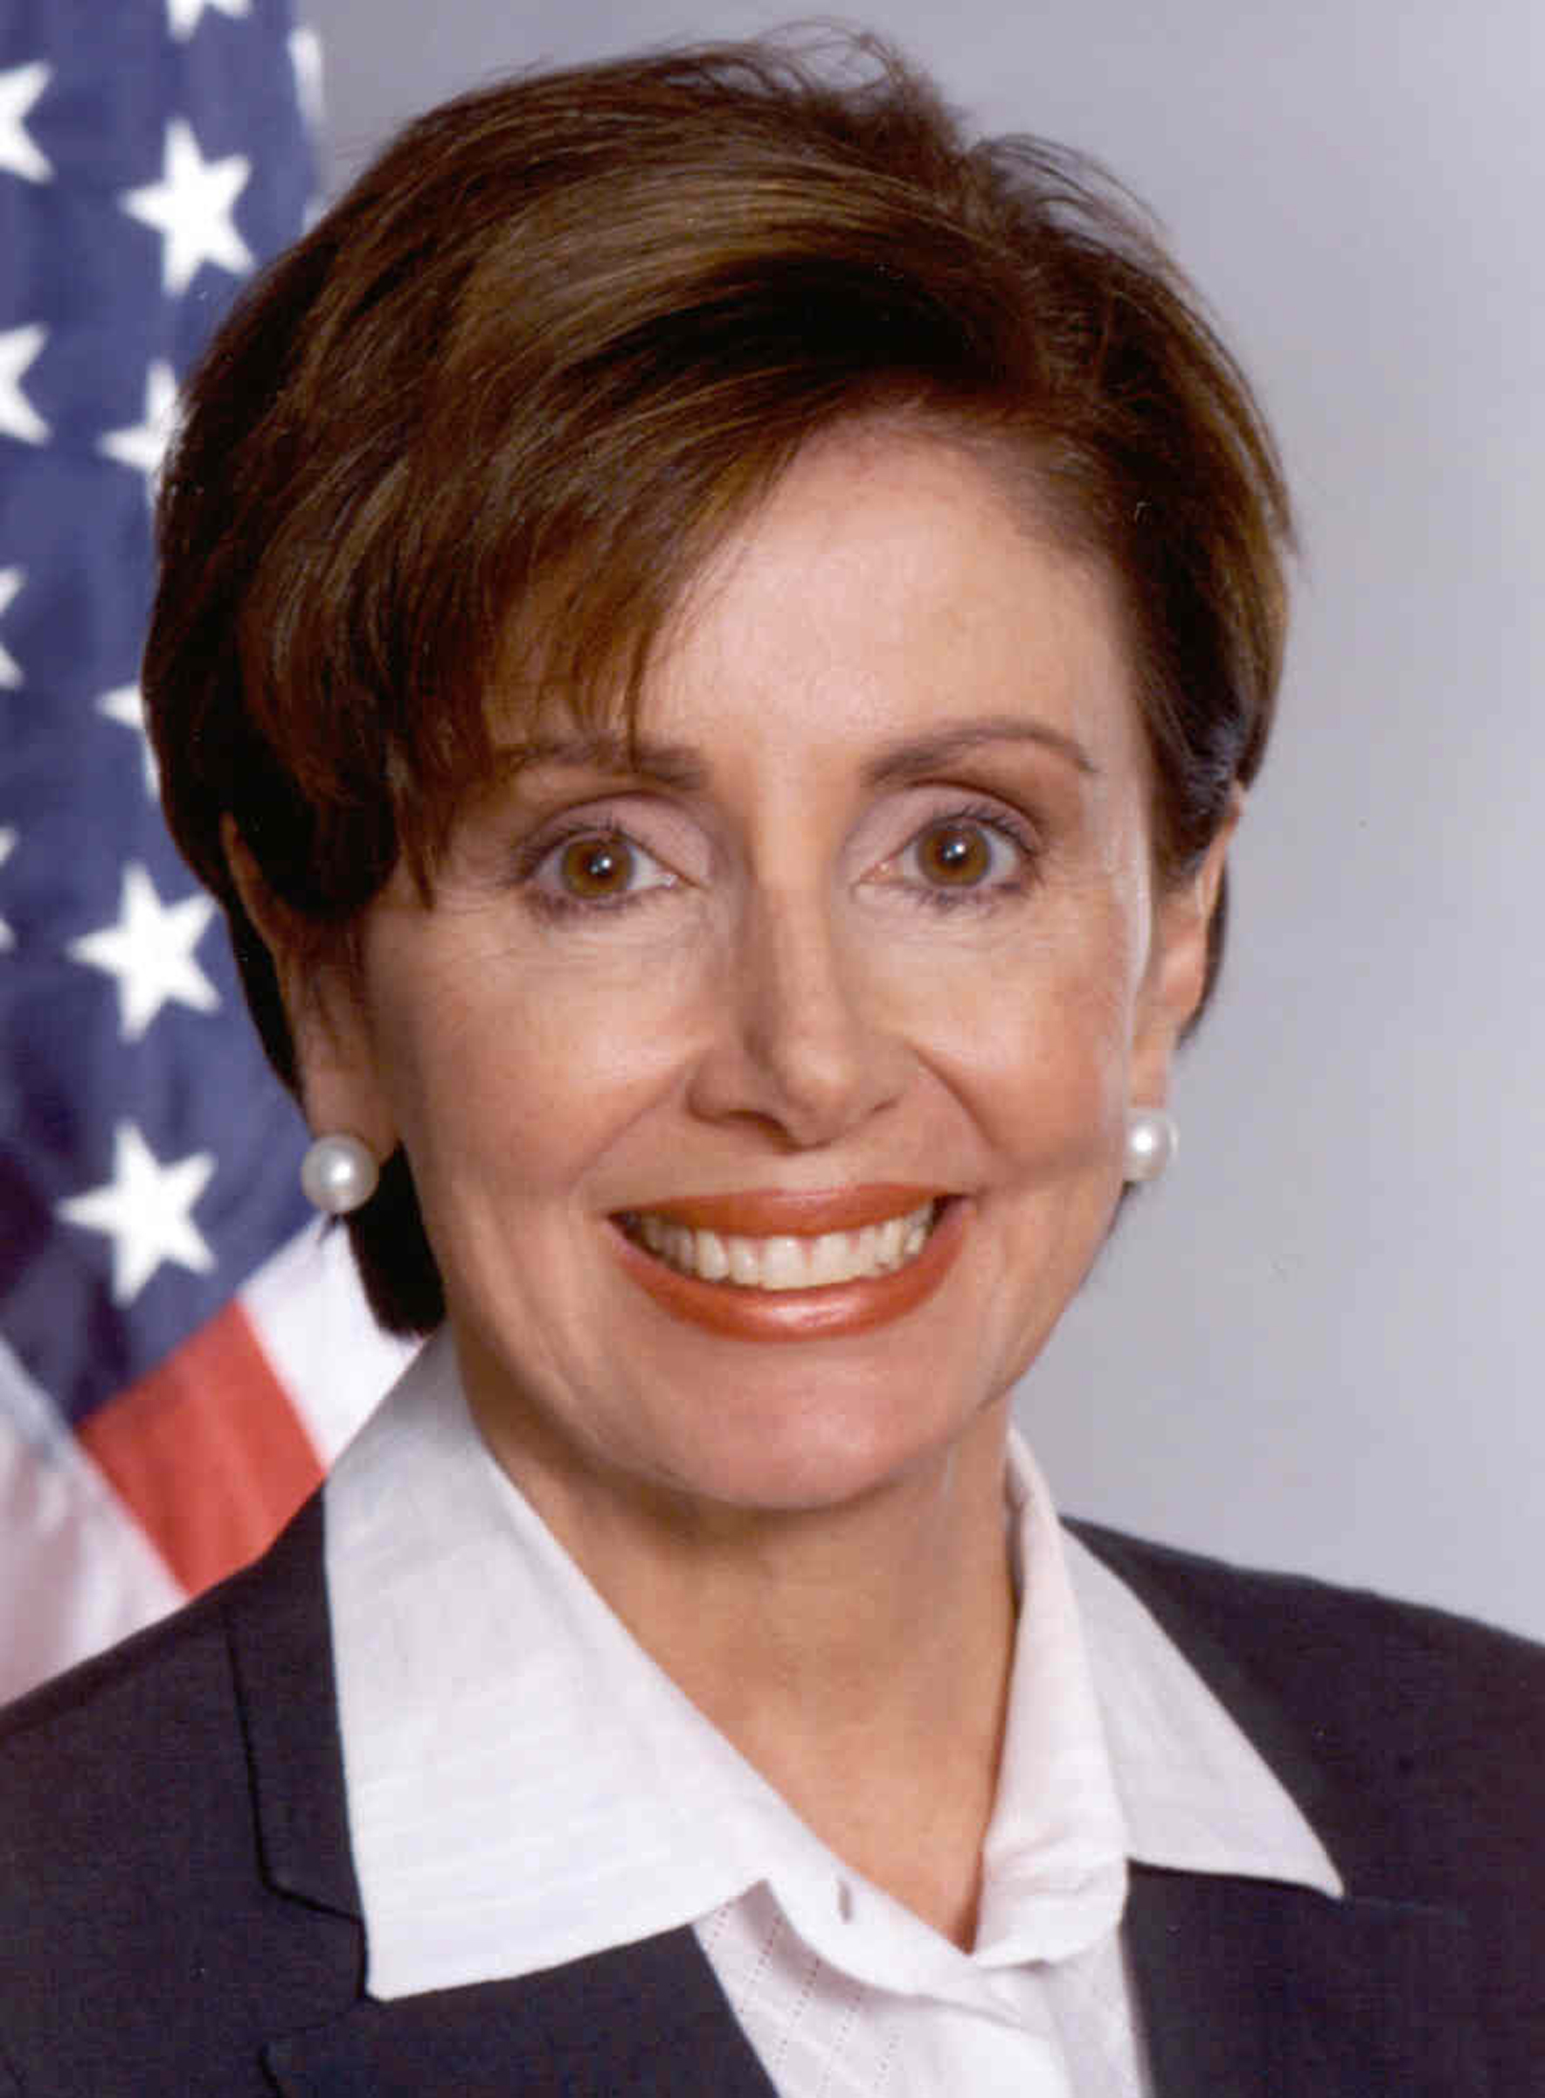
The Speaker of the House
The Speaker of the House of Representatives is the presiding officer.
The Speaker is second in the presidential line of succession, after the vice president.
The Speaker is elected on the first day of a new session of Congress by simple majority vote.
Joseph Gurney Cannon, Republican from Illinois, first elected in 1873, is considered to be the most powerful Speaker in U.S. history.
Nancy Pelosi, Democrat from California, first elected in 1987, is the first woman Speaker.
Sam Rayburn, Democrat from Texas, first elected in 1913, was longest-serving Speaker for 17 years.

Slide 29
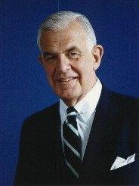
The Speaker of the House
Leader of the majority party.
Presides over the House.
Decides whom to recognize to speak on the floor.
Rules on germaneness (appropriateness) of motions.
Directs bills to the appropriate committee.
Influences which bills are brought up for a vote.
Appoints members of special and select committees.
Democrat Tom Foley was a moderate Speaker who opposed term limits. He was followed by Republican Newt Gingrich in 1995.

Slide 30
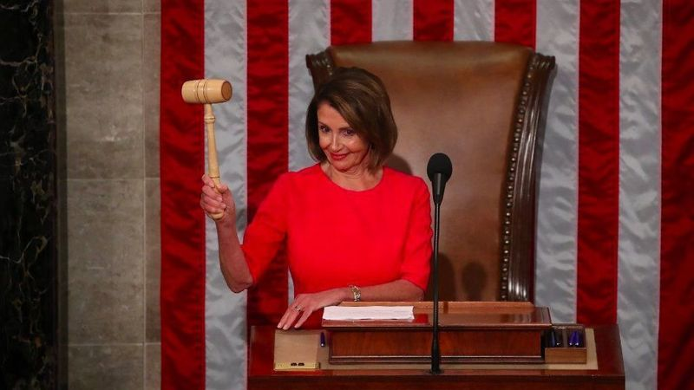
Speaker of the House Nancy Pelosi (D) California

Slide 31
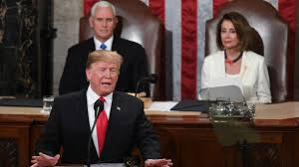
State of the Union Address

Slide 32
Majority and minority leaders
The majority leader serves as the major assistant to the speaker, helps plan the party’s legislative program, and directs floor debate.
The minority floor leader is the major spokesperson for the minority party and organizes opposition to the majority party.
Whips help floor leaders by direction party members in voting, informing members of impending voting, keeping track of vote counts, and pressuring members to vote with the party.

Slide 33
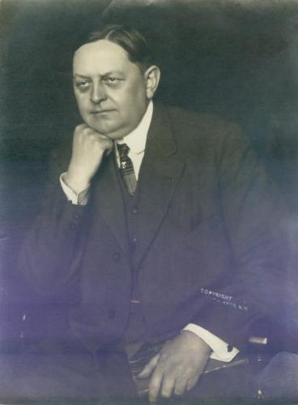
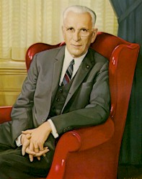
House Majority Leader
The House majority leader is elected by the party with the most members in the House.
The majority leader is second to the Speaker of the House in the majority party hierarchy.
The role of the majority leader is not specified by the Constitution.
The majority leader assists the Speaker with scheduling legislation, managing the House floor and unifying their political party.
Oscar Wilder Underwood, Democrat from Alabama, was House majority leader from 1911 to 1915
John William McCormack served as majority leader three different times, from 1941 to 1961

Slide 34
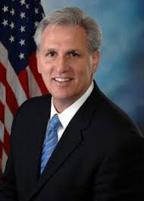
House Majority Leader Steny Hoyer (D) Maryland
House Minority Leader Kevin McCarthy(R) California

Slide 35
Senate
The U.S. vice president, although not a Senate member, it’s the presiding officer of the Senate, according to the Constitution. The vice president may not debate and only votes to break a tie.
The president pro tempore is a senior member of the majority party chosen to preside in the absence of the Senate president. This is a mostly ceremonial position lacking real power.

Slide 36
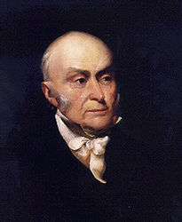
The President of the Senate
The Constitution states that the vice president of the United States is also the president of the Senate.
The most important job of the Senate president is to cast tie-breaking votes.
The vice presidents who cast the most tie-breaking votes are John Adams (during 1789–1797) with 29 and John Calhoun (1825–1832) with 28.
The Vice President of the United States shall be President of the Senate, but shall have no Vote unless they be equally divided.
—U.S. Constitution, Article I, Section 3, Clause 4

Slide 37
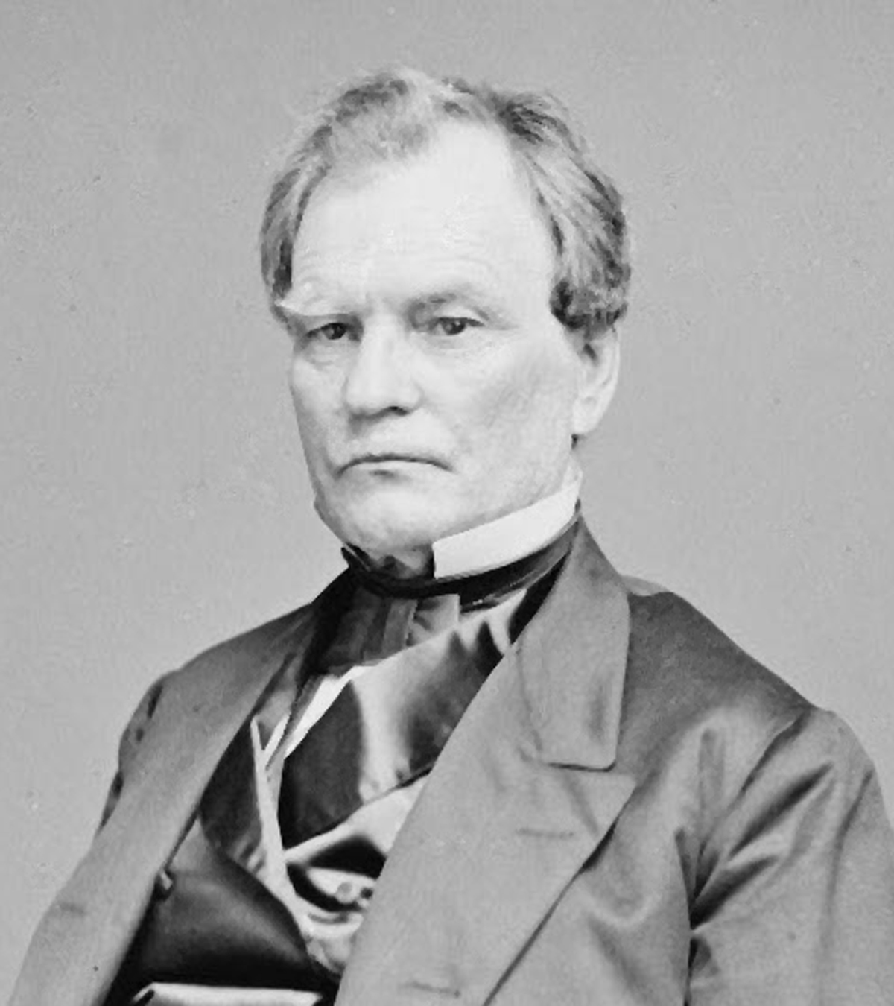
The President Pro Tempore of the Senate
The president pro tempore of the Senate is the highest-ranking senator and the second-highest-ranking official of the Senate.
The president pro tempore may preside over the Senate.
The president pro tempore is third in the line of succession to the presidency.
Had President Andrew Johnson, who had no vice president, been removed from office in 1868, Senate president pro tempore Benjamin Franklin Wade would have become president.
The Senate shall choose their other Officers, and also a President pro tempore, in the Absence of the Vice President, or when he shall exercise the Office of President of the United States. —U.S. Constitution, Article I, Section 3, Clause 5

Slide 38
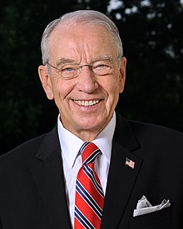
President Pro Tempore Charles Grassley (R) Iowa

Slide 39
Majority of the minority floor leaders
The majority floor leader is the most influential member of the Senate and often the majority party spokesperson.
The minority floor leader performs the same role as the House minority leader.
Whips serve the same role as whips in the House of Representatives.

Slide 40
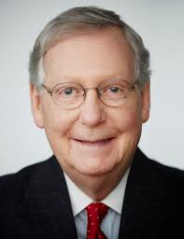
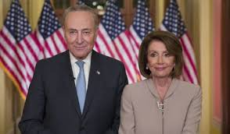
Senate Majority Leader – Mitch McConnell(D) Kentucky
Senate Minority Leader – Chuck Schumer (D) NY

Slide 41
Party Whips
Both the Democrats and Republicans elect a whip at the beginning of each Congress.
The term "whip" comes from the British foxhunting term "whipper in," meaning the hunter's assistant who keeps the hounds together in a pack.
The majority and minority whips are responsible for unifying their party members on important legislation.

Slide 42
The Committee System
Most of the work of Congress is accomplished through committee. Committees permit Congress to divide the work among members, thus allowing for the study of legislation by specialists and helping speed up the passage of legislation.

Slide 43
Leadership of Committees
Committee chairpersons are members of the majority party in each house chosen by party caucus. They set agendas, assign members to subcommittees, and decide whether the committee will hold public hearing and which witnesses to call. They manage floor debate of the bill when it is presented to the full House or Senate.

Slide 44
Traditionally chairpersons were chosen based on the seniority system, with the majority party member having the longest length of committee service chosen as chairperson. Today, reforms allow for the selection of chairpersons who are not the most senior majority-party member on the committee. However, most are long-standing members on the committee.

Slide 45
Membership of Committees
The percentage of each committee’s membership reflects the overall percentage of Democrats and Republicans in each house. Members try to serve on committees where they can influence public policy relating to their district to state (for example, a Kansas senator on the agriculture committee) or influence national public policy issues (an Iowa representative on the foreign relations committee).

Slide 46
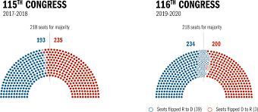
116th Congress

Slide 47
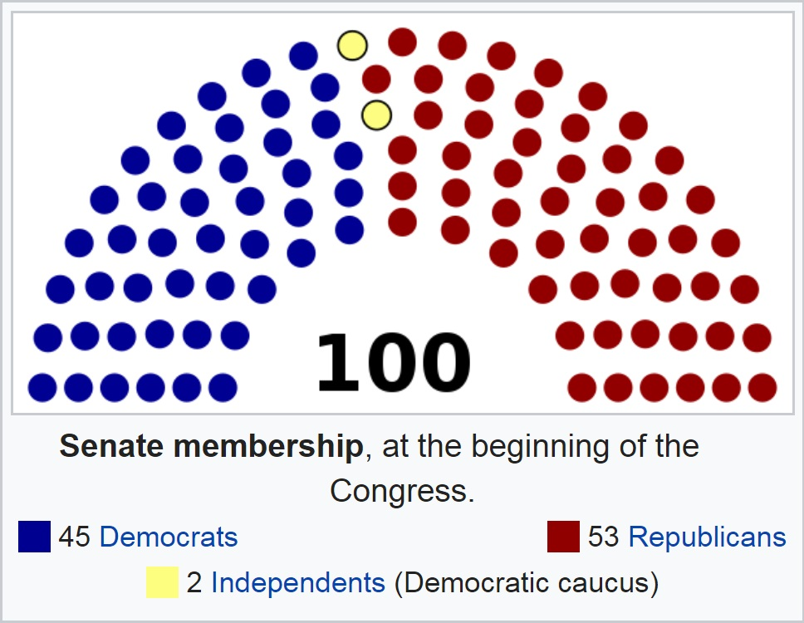
The United States Senate-2019

Slide 48
Types of Committees
A standing committee is a permanent committee that deals with specific policy matters (agriculture, energy and natural resources, veterans affairs).
A select committee is a temporary committee appointed for a specific purpose. Most are formed to investigate a particular issue, such as the Senate Watergate Committee.

Slide 49
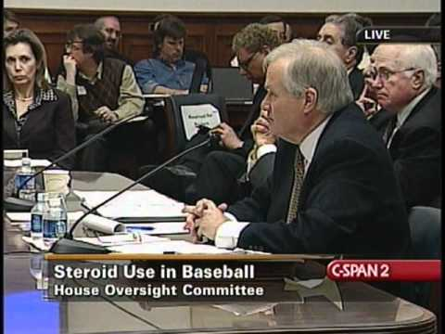

Slide 50
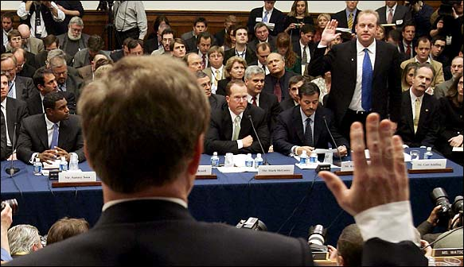

Slide 51
A joint committee is made up of members of both houses of Congress. It may be a select committee (Iran-Contra Committee) or perform routine duties (Joint Committee on the Library of Congress)
A conference committee is a temporary committee of members from both houses of Congress, created to resolve the differences in House and Senate versions of a bill. It is a compromise committee.

Slide 52
House Committees
Both the House and the Senate have committees.
Standing committees are permanent committees that carry out long-term study and action on special issues.
Select committees are established to investigate and report on short-term issues. They are temporary and generally do not send or report bills to Congress.
Joint committees serve as forums for cooperation between both houses.
Oil executives testify before the Senate Judiciary Committee
House Judiciary Committee

Slide 53
House Committees
Agriculture
Appropriations
Armed Services
Budget
Education & Labor
Energy & Commerce
Financial Services
Foreign Affairs
Homeland Security
House Administration
Judiciary
Natural Resources
Rules
Oversight & Reform
Science & Technology
Small Business
Standards of Official Conduct
Transportation & Infrastructure
Veterans' Affairs
Ways & Means
Joint Economic Committee
Joint Committee on Printing
Joint Committee on Taxation
House Permanent Select Committee on Intelligence
Select Committee on Energy Independence & Global Warming

Slide 54
Senate Committees
Agriculture, Nutrition, and Forestry
Appropriations
Armed Services
Banking, Housing, and Urban Affairs
Budget
Commerce, Science, and Transportation
Energy and Natural Resources
Environment and Public Works
Finance
Foreign Relations
Health, Education, Labor, and Pensions
Homeland Security and Governmental Affairs
Judiciary
Rules and Administration
Small Business and Entrepreneurship
Veterans' Affairs
Indian Affairs
Select Committee on Ethics
Select Committee on Intelligence
Special Committee on Aging
Joint Committee on Printing
Joint Committee on Taxation
Joint Committee on the Library
Joint Economic Committee

Slide 55
Caucuses
Caucuses are informal groups formed by members of Congress who share a common purpose or set of goals (Congressional Black Caucus, Women’s Caucus, Democratic or Republican Caucus).

Slide 56
Congressional Staff and Support
Personal Staff work directly for members of Congress in Washington D.C., and their district offices in their home states.
Committee Staff work for committees and subcommittees in Congress, researching problems and analyzing information.
Support agencies provide services to members of Congress (Library of Congress, Government Printing Office).

Slide 57
Roles of Members of Congress
Members of Congress have several roles.
Policymaker – make public policy through the passage of legislation
Representative – represent constituents
-delegate- members vote based on the wishes of constituent, regardless of their own opinions
-trustee- after listening to constituents, members vote based on their own opinions
Constituent servant – help constituents with problems
Committee member – serve on committees
Politician/party member – work to support their political party platform and get reelected

Slide 58
Privileges of Members of Congress
Members of Congress enjoy several privileges, including:
Allowances for offices in their district or home state
Travel allowances
The franking privilege allows members of Congress to send mail to constituents postage free
Immunity from arrest while conducting congressional business
Immunity from libel or slander suits for their speech or debate in Congress

Slide 60
Powers of Congress
Congress has legislative and non-legislative powers.
Legislative powers – power to make laws
Expressed powers – powers specifically granted to Congress, mostly found in Article I, Section 8 in the Constitution
Implied powers – powers that may be reasonably suggested to carry out the expressed powers; found in Article I, Section 8, Clause 18; “necessary and proper” or elastic clause; allows for the expansion of Congress’ powers (expressed power to raise armies and navy implies the power to draft men into the military)
Limitations on powers - powers denied by Congress by Article I, Section 9 and the Tenth Amendment

Slide 61
2. Non-legislative powers – duties other than lawmaking
Electoral powers – selection of the president by the House of Representatives and/or vice president by the Senate upon the failure of the electoral college to achieve a majority vote
Amendment powers – congress may propose amendments by two-thirds vote of each house or by calling a national convention to propose amendments if requested by two-thirds of the state legislatures

Slide 62
Impeachment – the House may bring charges, or impeach, the president, vice president or any civil officer; case if tried in the Senate with the Senate acting as the jury (Andrew Johnson and Bill Clinton were both impeached by the House but not convicted by the Senate)
Executive powers of the Senate – the Senate shares the appointment and treaty making powers with the executive branch; the Senate must approve appointments by majority vote and treaties by two-thirds vote
Investigative/oversight powers – investigate matters falling within the range of its legislative authority; often involves the review of policies and programs of the executive branch

Slide 63
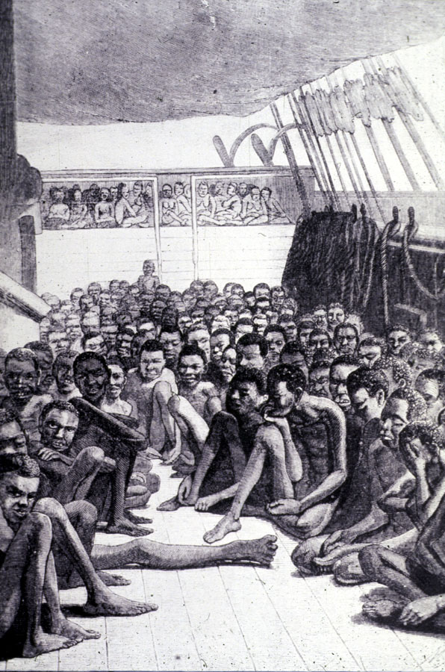
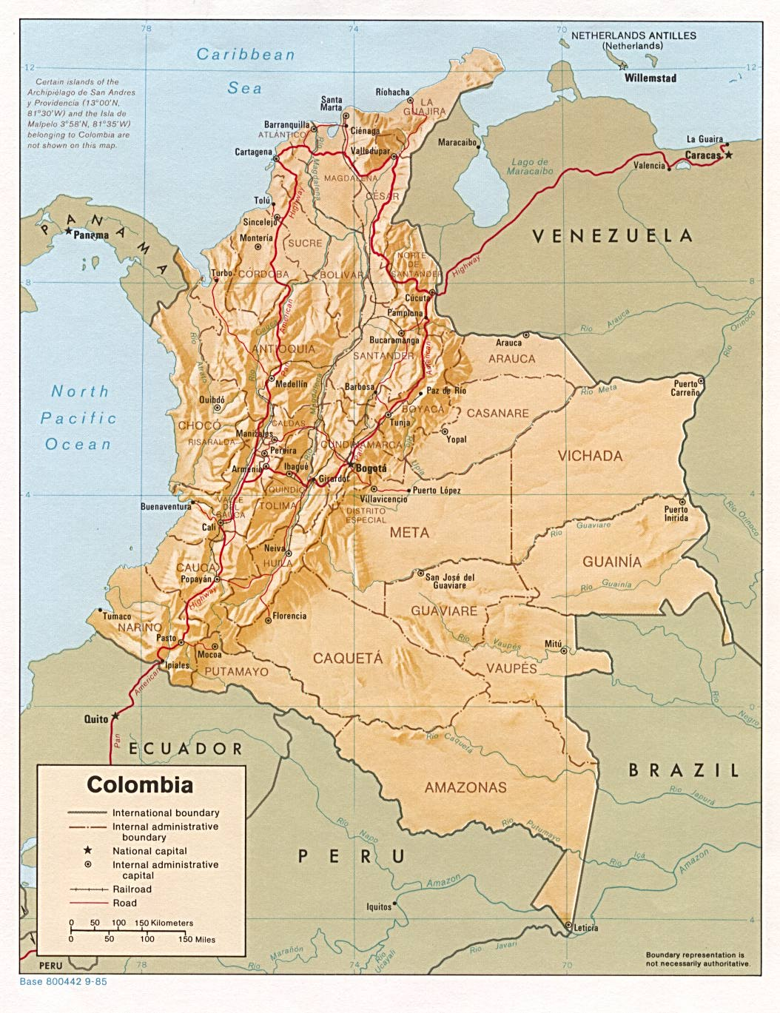
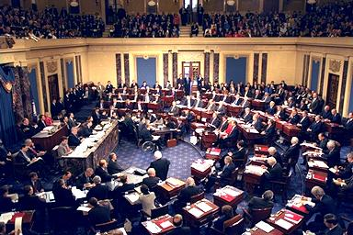
Special Duties of the Senate
Confirm international treaties.
Confirm presidential appointments, such as cabinet secretaries, Supreme Court justices, and ambassadors.
Put on trial government officials who have been impeached by the House.
The first international treaty rejected by the Senate was with Colombia for the suppression of the African slave trade in 1825.
Impeachment trial of President William Jefferson Clinton, Justice Rehnquist presiding.

Slide 64
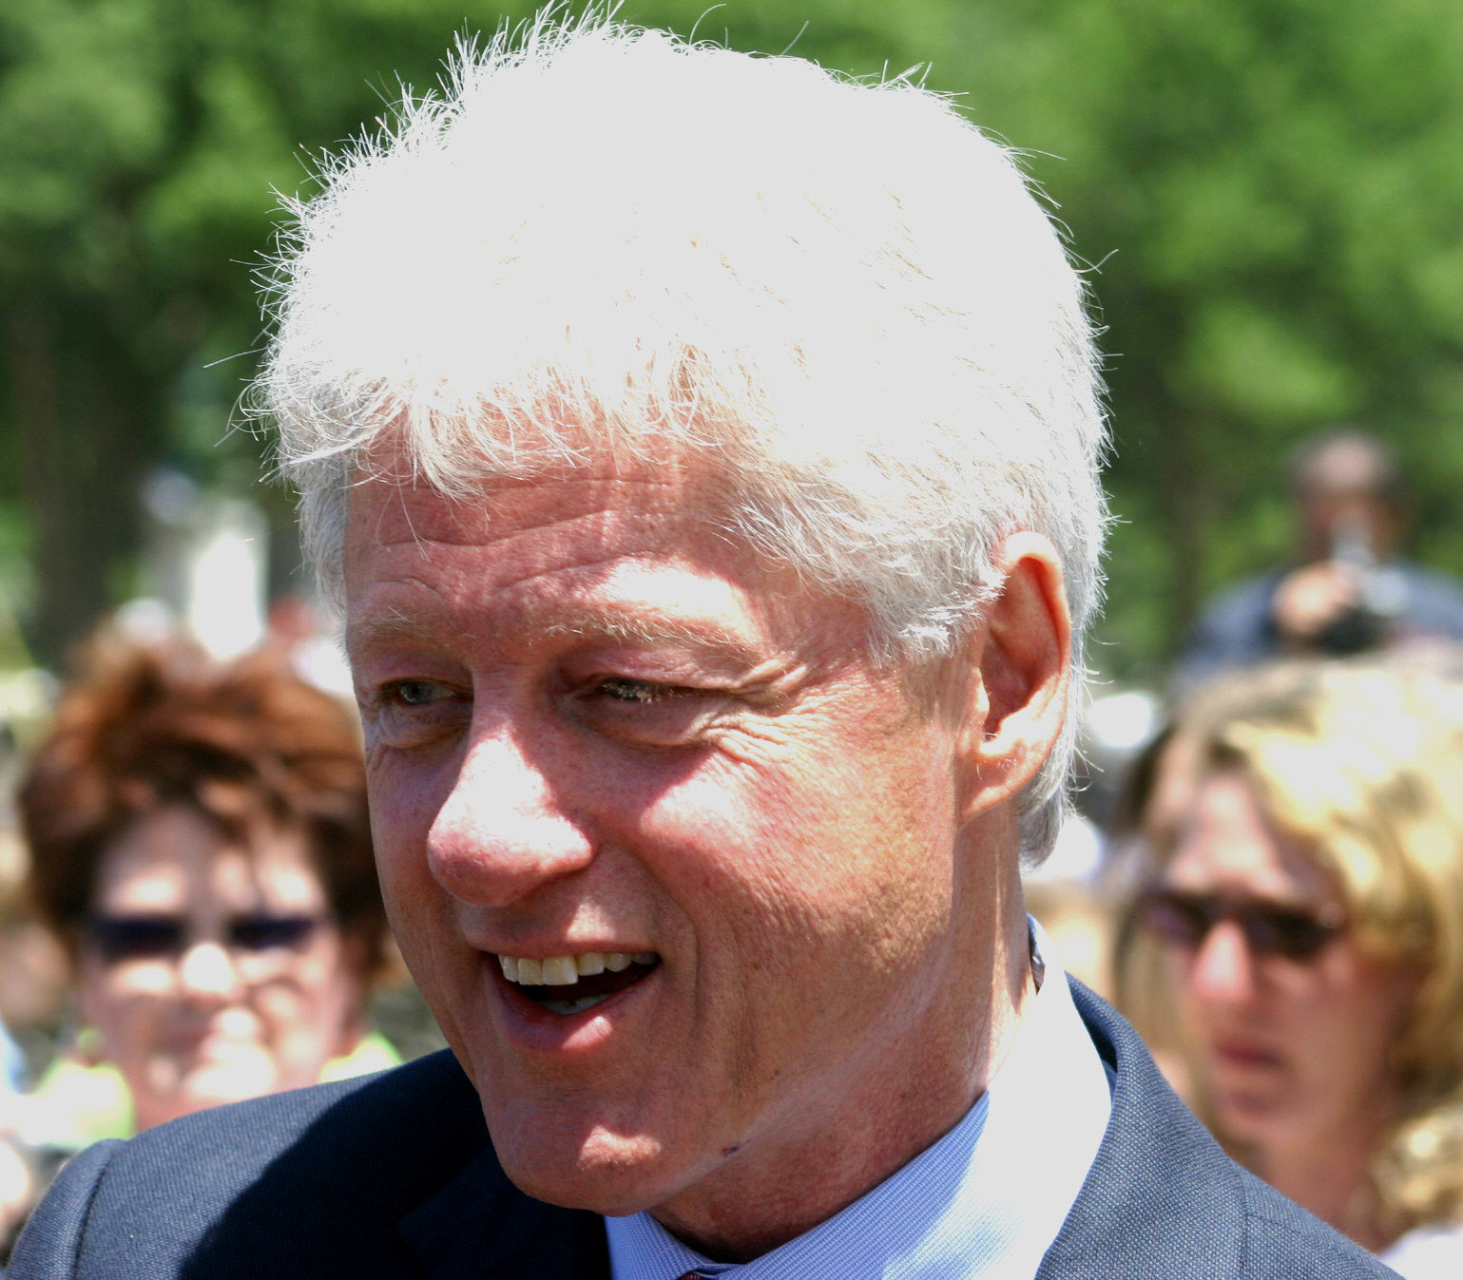
The Senate shall have the sole power to try all impeachments: Article I, Section 3
President Richard Nixon resigned before his impeachment trial in 1974.
The Senate tried and acquitted President Bill Clinton in 1999.
Acquitted: declared not guilty

Slide 65
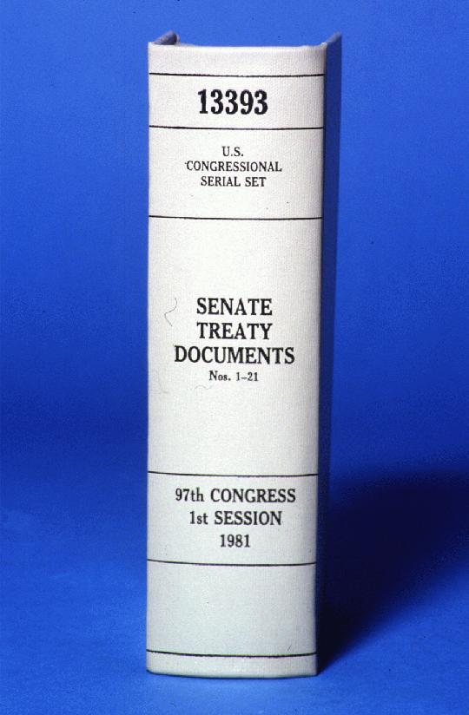
The Senate has the power to accept or reject treaties.
The President ... shall have Powers, by and with the Advice and Consent of the Senate, to make Treaties, provided two thirds of the Senators present concur ...
—U.S. Constitution, Article II, Section 2, Clause 2

Slide 66
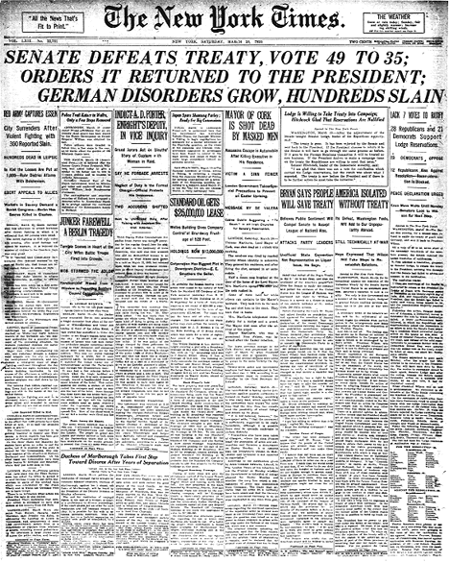
Treaty of Versailles ending World War I

Slide 67
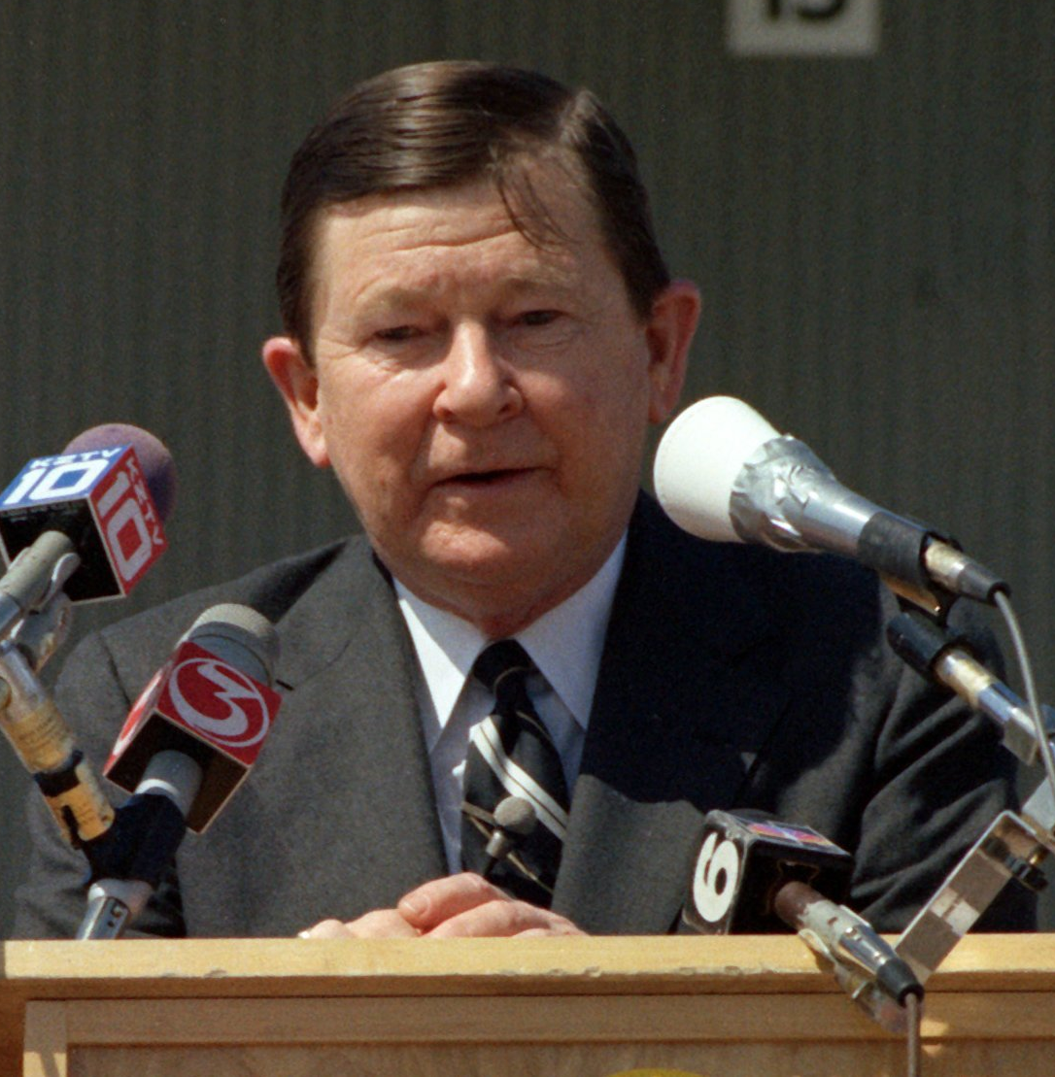
Presidential Nominees
The president ... shall nominate, and by and with the Advice and Consent of the Senate, shall appoint Ambassadors, other public Ministers and Consuls, Judges of the supreme Court, and all other Officers of the United States ...
—U.S. Constitution, Article II, Section 2, Clause 2
The Senate has only rejected nine presidential cabinet nominees. The first was Roger B. Taney (left), nominated by Andrew Jackson as secretary of the treasury in 1834; the last was Senator John G. Tower (right), nominated by George Bush as secretary of defense in 1989. Eleven other nominees have withdrawn their nominations before being rejected.

Slide 68
The Lawmaking Process
Bills, or proposed laws, may begin in either house, except revenue bills, which must begin in the House of Representatives.

Slide 70
The legislative process is, by design, slow, deliberate and complicated. This is to prevent Congress from acting hastily.
The Framers intended for the process to foster compromise. The result has been that the final version of bills are often radically different from initial versions. Without compromise, there would be no legislative process.

Slide 71
As many as 10,000 bills are proposed on the floor of Congress each year. Some are written by members of Congress, some by members of Congress’s staffers, others by special interest groups and their lawyers and then submitted by members of Congress.
Regardless of who writes a bill, a member of Congress MUST submit the bill; this is called sponsoring a bill.

Slide 72
The legislative process requires both houses of Congress to work cooperatively. All bills must pass in both houses of Congress in the exact same (verbatim) form! While the bills must be verbatim, the debate and voting process within the House and the Senate differ from one another. Because there are 435 members in the House, the extent of debate is more limited than in the Senate, which has fewer rules.

Slide 73
Unlike the Senate, the House has a Rules Committee, which is responsible for determining how long a bill will be debated and whether to allow an open or closed rule for amending the bill. Open rules allow amendments to a bill, a closed rule allows no amendments to a bill.

Slide 74
While the House strictly controls voting and debate on bills, the Senate does not! There are no time restraints placed on Senators. Filibusters occur when senators speak with no intention of stopping. It is their intent to delay a vote on the bill and to tie up the agenda of the Senate. The only way of stopping a filibuster is to vote for cloture, but this requires 60 senators to vote to stop the filibuster, obviously a difficult task.

Slide 75
The Filibuster
The filibuster is a procedure whereby a senator or group of senators may speak on any topic for as long as they wish unless 60 senators invoke cloture.
Cloture: A measure that ends debate and brings the bill to an immediate vote. In 1917, the Senate adopted the rule of cloture requiring a two-thirds majority vote. The cloture vote was reduced to 60 senators in 1975.

Slide 76
A filibuster delays the vote and prevents other legislation from being discussed.
The threat of a filibuster may force changes or withdrawal of proposed legislation.
A weary senator rests on a cot in the old Senate chamber during a lengthy filibuster. Photo: U.S. Senate Historical Office

Slide 77
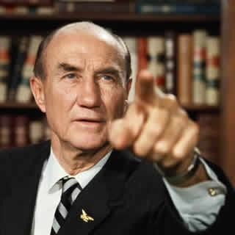
Longest Filibuster: Strom Thurmond (R) South Carolina
Spoke in opposition to the Civil Rights Act of 1957…
For 24 hours and 18 minutes!

Slide 78
The Senate has no closed rules for amending legislation. Amendments, called riders, do not have to be germane to a bill. This allows individual senators an opportunity to add amendments, such as “earmarks” for their home state or congressional district.
Projects that are directed at bringing money or amenities to a Congressperson’s state or congressional district are called earmarks or pork barrel legislation (bring home the bacon) and is one reason that incumbents have such a high reelection rate.

Slide 79
After debate, bills usually end up passing the House and Senate in different forms. A Conference Committee is then called where members of both houses of Congress meet and create a new bill that is the finalized and identical form that must be then passed in both houses of Congress.
Failure to reach a negotiated bill kills the bill; if the bill is passed in identical form in both houses, it is sent to the President for his approval.

Slide 80
The President can then:
(1) sign the bill and make it a law,
(2) veto (literally “I forbid”) and send it back to Congress with an explanation on why he didn’t sign the bill. It can then be overridden with a 2/3 vote in both houses,
(3) do nothing and the bill becomes law after ten days,
(4) If Congressional session ends before the ten day limit and the president does not sign the bill, the bill dies; this is called a Pocket Veto.

Slide 81
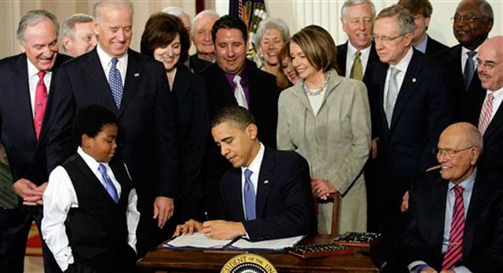
Signing the Health Care Bill

Slide 82
House of Representatives | Senate
A bill is introduced, numbered, and assigned to a committee. The bill may be assigned to a subcommittee for a further study. The bill is returned to committee, where it is approved or rejected. The rules committee sets terms of debate for the bill. The bill is debated by the House. A vote is taken, where the bill is passed or defeated. Bills that pass the House are sent to the Senate. | A bill is introduced, numbered, and assigned to a committee. The bill may be assigned to a subcommittee for a further study. The bill is returned to committee, where it is approved or rejected. No rules committee! The bill is debated by the Senate. A vote is taken, where the bill is passed or defeated. Bills that pass the House are sent to the Senate.

Slide 83
Legislative Tactics
Legislative tactics are the strategies and devices used by Congress and others in an attempt to block legislation or to get legislation passed.
Caucuses – May form voting blocs.
The committee system – Plays a major role in the passage of legislation; bills may die if committees fail to act upon them or reject them.
Filibuster and cloture—Filibuster is unlimited debate in an attempt to stall action on a bill. It occurs in the Senate only, and is possible because the Senate’s rules for debate are almost unrestricted. Cloture is the method by which the Senate limits a filibuster. It involves a petition to end debate and requires the vote of at least 60 Senators.

Slide 84
Pork Barrel Legislation—An attempt to provide funds and projects for a member’s home district or state.
Logrolling—An attempt by members to gain the support of other members in return for their support on the member’s legislation; “I’ll support your bill, if you will support mine.”
Riders—Additions to legislation which generally have no connection to the legislation; generally legislation that would not pass on its own merit; when a bill has lots of riders it becomes a “Christmas Tree Bill.”

Slide 85
Amendments—Additions or changes to legislation that deal specifically with the legislation.
Lobbying—Trying to influence members of Congress to support or reject legislation.
Conference Committees—May affect the wording and therefore the final intent of the legislation.
Legislative Veto—The rejection of a presidential or executive branch action by a vote of one or both houses of Congress, used mostly between 1932 and 1980 but declared unconstitutional by the Supreme Court in 1983 (Immigration and Naturalization Service v. Chadha) stating that Congress cannot take any actions having the force of law unless the president agrees.

Slide 86
Influences on Congress
Various individuals and groups influence Congress members.
Constituents—Members, especially those who hope to win reelection, often take into consideration the opinions of their constituents and voters back home in their district or state.
Other lawmakers and staff—More senior members often influence newer members; committee members who worked on legislation often influence other members; and staff often research issues and advise members.

Slide 87
Party Influence—Each party’s platform takes a stand on major issues, and loyal members often adhere to the “party line.” Members in the House are more likely to support the party position than are Senators.
President—Presidents often lobby members to support legislation through phone calls, invitations to the White House, or even appeals to the public to gain support from voters to bring pressure on members.
Lobbyists and Interest Groups—often provide members with information on topics relating to their group’s interest or possible financial support in future campaigns.

