Slide 1
EXPANDING MARKETS and MOVING WEST

Slide 2
U.S. Markets Expand
Early in the 19th century farmers were self-sufficient
As the US became more industrialized (textile mills and factory systems) lives changed for workers and consumers
Farmers began to specialize and would raise one or two cash crops that they would sell
This introduced the MARKET REVOLUTION- time in which people bought and sold goods instead of making them for their own use.

Slide 3
Entrepreneurial Spirit
Goods and services multiplied and incomes rose
Capitalism: the economic system in which private businesses and individuals control the means of production
Investors were called ENTREPRENEURS (means to undertake).
They risked their own money for
a chance to make a profit

Slide 4
New Inventions- goods to make life more comfortable ☺
Elias Howe- invention of the first sewing machine.
Isaac Singer added the foot treadle which cut the time down that was spent on sewing garments
Less time= cheaper prices… which leads to more people buying clothes rather than making them their selves!

Slide 5
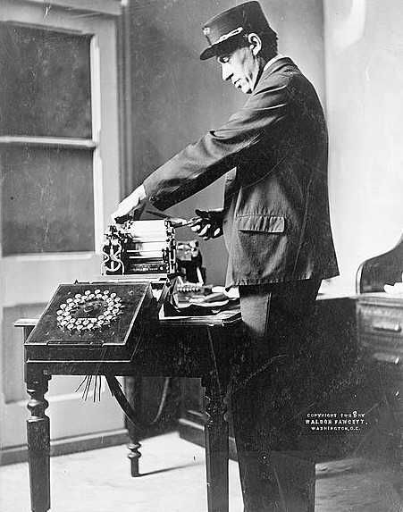
The Telegraph
Samuel F. B. Morse created the telegraph in 1837 to carry messages, tapped in code, across copper wire
Connected all large cities of the East Coast
Businesses and even the railroads used the telegraph to communicate sales, prices, location of trains and safety information.

Slide 6
Transportation ties the nation together
Better & faster transportation was needed with the expansion of agriculture and industry
By 1830 steamboats traveled the nations rivers carrying heavy machinery and raw materials such as copper and lead
Canals such as the ERIE CANAL allowed shipping rates to drop 10% and lead to over 3,300 miles of Canals throughout the country

Slide 7
Improved Transportation…THE RAILROAD
Costing more than shipping by boat the railroads offered the advantage of speed.
Benefits:
Could ship in the winter
Brought goods inland to the people
Safe and reliable
EXCITING and NEW
By 1840s steam engines pulled freight at ten miles per hour (4x the speed of canal boats)
By 1850 almost 10,000 miles of track had been laid and 2 billion tons of freight was being transported yearly

Slide 8
New Markets Link Regions
Southern Agriculture | Northeast Shipping and Manufacturing | Midwest Farming
-Most of the South remained Agriculture and grew crops such as cotton,, tobacco and rice -Looked at the North’s factories as filthy and overcrowded. -All of Southern $ was tied up in land and slaves -New transportation and communication was less advances in the South *Still new markets and interdependencies were created | -Canals and Railroads turned this area into the center of Commerce -This is where the North met the South Example: The Erie Canal brought more cotton through New York city to the factories than any other city. *The North and South worked together to make more and better goods at lower prices than ever before! | -Many moved to the Midwest to farm -Land had to be made arable (fit to farm) -John Deere (blacksmith) invented the first steel plow. *allowed less animal power -Cyrus McCormick invented the Mechanical Reaper which permitted one farmer to do the work of five. Subsistence farming V. Cash Crops

Slide 9
-Many Americans assumed that the United States would extend its dominion to the Pacific Ocean and create a vast republic that would spread the blessings of Democracy and civilization across the Continent
-Thomas Jefferson had dreamed the US would expand to meet the needs of many generations to come. *The LA Purchase helped reach this goal (and doubled the size of the nation)
-Westward expansion was not common and many believed the movement west and south was destined by GOD
The term “Manifest Destiny” was coined because of these beliefs
They believed that this destiny was manifest, or obvious

Slide 12
Attitudes toward the Frontier
Americans had practical reasons for moving West
The Panic of 1837 sent many West in order to get a “fresh start”
Abundance of land was an attraction
As farmers and miners moved, merchants followed seeking new markets
New harbors in Oregon Territory promised new trade with Asia

Slide 13
Settlers and Native Americans
New settlers West threatened the Native Americans communities
Many NA tried to maintain strong cultural traditions, even if they were forced to move
Some Assimilated or became part of the advancing white culture
Others fought hard to keep the settlers away

Slide 14
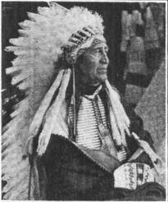
The Black Hawk War
Early 1830s White settlers put pressure on NA of Western Illinois and Eastern Iowa to move West of the Mississippi River
The tribes visited Chief Black Hawk of the Sauk Tribe and told them a vision in which they saw Black Hawk leading the people to reclaim the land stolen from them by the white man
Rebellion was lead and ended with the slaughtering of more than 200 Sauk and Fox people
Tribes were forcibly removed of their land and placed West of the Mississippi River
Black Hawk was imprisoned by the Federal Gov’t and once released could not assume any leadership roles among his tribesman

Slide 16
Peace and a Treaty
Middle Ground- settlers needed NA as trading partners and guides. *Relationship could be beneficial
Fort Laramie Treaty-Many Native American Tribes joined with US Representatives in swearing “to maintain good faith and friendship in all their mutual intercourse, and to make an effective and lasting peace.”

Slide 17
Trails West

Slide 18
The Santa Fe Trail | The Oregon Trail
-Busiest and most well know trail -led 780 miles from Independence, Missouri to Santa Fe, New Mexico -Wagons were band together for security Would trade guns, knives and cloth for silver, gold and fur *first established American presence in New Mexico and Mexican providence of Arizona | -In 1836 Methodist Missionaries Marcus and Narcissa Whitman made their way to Oregon Territory where they set up mission schools to convert NA to Christianity and to educate them --Trail started in Independence, Missouri and ended in Portland, Oregon -Letters written by the missionaries brought new settlers because of the promise of fertile soils and abundant rainfall -Many who traveled the harsh trail died of disease (fever, diarrhea, cholera) and where buried along the trail -Other hardships included possible attacks by the Native Americans and the loneliness of the difficult journey

Slide 20
The Mormon Migration
Mormons, a religious community also know as the Latter- Day Saints, played a major role in settling the West
Religion began in Western New York (1827) when Joseph Smith and five associates established the Church
Smith and a growing band of followers moved West and settled in Nauvoo, Illinois (1839)

Slide 21
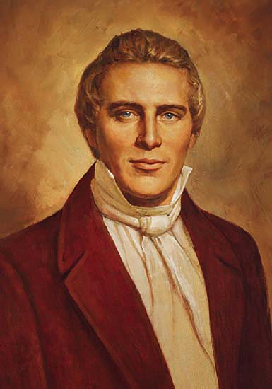
Joseph Smith
Brigham Young

Slide 22
Within five years the community numbered 20,000.
Many neighbors became angry and printed protests against polygamy and other practices of this early church
Joseph Smith destroyed the towns printing press and was jailed for treason
An anti- Mormon mob broke into the jail and murdered Smith and his brother

Slide 23
Smith’s Successor
Brigham Young decided to move his followers where they could be free from persecution
Mormons traveled by wagon north to Nebraska, across Wyoming to the Rockies, and then Southwest.
In 1847, the Mormons stopped in the desert near the Great Salt Lake.
Mormons awarded land to families based on their size. Farms and settlements flourished
Salt Lake City blossomed out of the land the Mormons called Deseret

Slide 24
Resolving Territorial Disputes
1844 President Polk called for the annexation of the entire Oregon Territory.
Adopted the slogan “Fifty- Four Forty or Fight”
This referred to the latitude of the land.
By the mid 1840s Britain lost interest in the territory because of the diminishing fur trade
United States and Britain worked peacefully together to extend the boundary of the US to the Canadian Border we have today.
**The establishment and settlement of the Southwest would NOT be that easy!

