Slide 1
Civil Rights and Civil Liberties

Slide 2
Summary
In the Declaration of Independence, Thomas Jefferson wrote that all people “are endowed by their creator with certain un alienable rights.” Civil liberties are those rights that belong to everyone; they are protections against government and are guaranteed by the Constitution, legislation, and judicial decisions. Civil rights are the positive acts of government, designed to prevent discrimination and provide equality before the law.

Slide 3
Civil Rights
Civil rights are guaranteed by the Equal Protection Clause of the 14th. Amendment, which was added to the Constitution after the Civil War to prevent states from discriminating against former slaves and to protect former slaves’ rights.

Slide 4
The courts recognize that some forms of discrimination may be valid (preventing those under 21 from consuming alcohol) and have therefore devised the rational basis test to determine if the discrimination has a legitimate purpose. The courts have also developed the strict scrutiny test, a much stricter standard.
If the discrimination reflects prejudice, the courts automatically classify it as suspect and require the government to prove a compelling reason for the discrimination. For example, if a city had separate schools for different races, the city would have to prove how this serves a compelling public interest.

Slide 5
The Civil Rights Movement
After the Civil War three amendments were passed to ensure the rights of the former slaves.
The 13th Amendment abolished slavery.
The 14th Amendment defined citizenship to include the former slaves and provided for due process and equal protection, which were used by the Supreme Court to apply the Bill of Rights to the state and local governments.

Slide 6
The 15th Amendment provided that individuals could not be denied the right to vote based on race or the fact that they were once a slave. Until the 1950s and 1960s states continued to use discriminatory practices to prevent African Americans from participating in the political processes.
Block codes were state laws passed to keep former slaves in state of political bondage. The laws included literacy tests, poll taxes, registration laws, and white primaries.

Slide 7
The Civil Rights Act of 1875 outlawed racial discrimination in public places such as hotels, theaters, and railroads but required African Americans to take their cases to federal court, a time-consuming and costly endeavor. The act was ruled unconstitutional in 1883.
Jim Crow laws were laws designed to segregate the races in schools, public transportation, and hotels.
In Plessy v. Ferguson (1896) the Supreme Court upheld the Jim Crow laws by allowing separate facilities for the different races if those facilities were equal. This created the separate but equal doctrine.

Slide 8
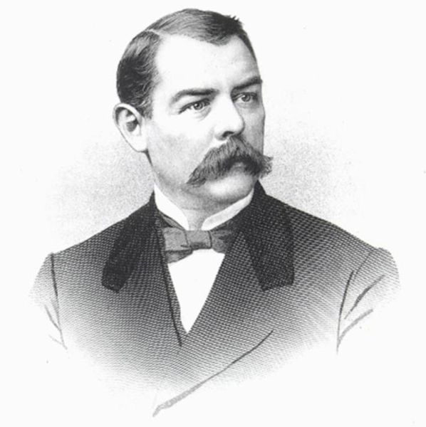
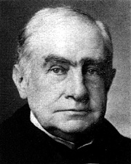
Plessy v. Ferguson
The Supreme Court, under Chief Justice Melville Fuller, upheld racial segregation in public accommodations under the doctrine of separate but equal by a vote of seven to one in Plessy v. Ferguson, 1896.
Radical Republican lawyer Albion W. Tourgée argued the plaintiffs’ case.
Writing for the court, Justice Brown ruled, "We consider the underlying fallacy of the plaintiff's argument to consist in the assumption that the enforced separation of the two races stamps the colored race with a badge of inferiority. If this be so, it is not by reason of anything found in the act, but solely because the colored race chooses to put that construction upon it."
Albion W. Tourgée
"Justice is pictured as blind and her daughter the Law, ought at least to be color-blind."
Justice Henry Billings Brown
Chief Justice Fuller

Slide 9
With Executive Order 8802 (1941) Franklin Roosevelt banned racial discrimination in the defense industry and government offices.
With Executive Order 9981 (1948) Harry Truman ordered the desegregation of the armed forces.
In Brown v. Board of Education (1954) the Supreme Court overturned the Plessy decision, ruling that separate but equal is unconstitutional.

Slide 10
In Brown v. Board of Education II (1955) the Supreme Court ordered the desegregation of schools “with all deliberate speed.”
The Civil Rights Act of 1957 created the Civil Rights Division within the Justice Department and made it a crime to prevent a person from voting in federal elections.

Slide 11
The Civil Rights Act of 1964 prohibited discrimination in employment and in places of public accommodation, outlawed bias in federally funded programs, and created the Equal Employment Opportunity Commission's (EEOC).
The Twenty-Fourth Amendment (1964) outlawed poll taxes in federal election.
The Voting Rights Act of 1965 allowed federal registrars to register voters and outlawed literacy tests and other discriminatory tests in voter registration.
The Civil Rights Act of 1991 made it easier for job applicants and employees to bring suit against employers with discriminatory hiring practices.

Slide 12
Other Minorities
With the successes of the African American civil rights movement, other minorities have also pressed to end discrimination. Hispanics, American Indians, Asian Americans, women, and people with disabilities have all joined in the quest for protection from discriminatory actions.

Slide 13
Hispanic Americans
Hispanic Americans is a term often used to describe people in the United States who have a Spanish-speaking heritage, including Mexican Americans, Cuban Americans, Puerto Ricans, and Central and South Americans. Today, the Hispanic population is the fastest growing minority in America.

Slide 15
Although the number of Hispanics elected to public office has increased since the 1970s, their progress continues to be hampered by unequal educational opportunities and language barriers. Civil Rights action on behalf of Hispanics has concentrated on health care for undocumented immigrants, affirmative action, admission of more Hispanic students to state colleges and universities, and redistricting plans that do not discriminate against Hispanic Americans.

Slide 16
Native Americans
More than two million Native Americans live on reservations in the United States. As a result of discrimination, poverty, and unemployment, are common problems. Lack of organization has hampered Native American attempts to gain political power. With the formation of militant organizations (National Indian Youth Council and American Indian Movement) and protests (siege at Wounded Knee), Native Americans have brought attention to their concerns.

Slide 17
A 1985 Supreme Court ruling upheld treaty rights of Native American tribes. The Indian Gaming Regulatory Act (1988) allowed Native Americans to have gaming operations (casinos) on their reservations, creating an economic boom in many tribes. In 1990 Congress passed the Native American Languages Act, encouraging the continuation of native languages and culture.

Slide 18
Asian Americans
Discrimination against Asians arriving in the United States began almost immediately as Asian workers began competing for jobs. Beginning in 1882, the Chinese Exclusion Act (and other similar acts) limited the number of Asians permitted to enter the U.S. After the bombing of Pearl Harbor, people of Japanese descent were forced into relocation camps.

Slide 19
The Supreme Court upheld these actions until 1944, when they declared the internments to be illegal in Korematsu v. U.S. In 1988 Congress appropriated funds to compensate former camp detainees or their survivors.

Slide 20
The Women’s Movement
Throughout much of American history, women have not been given the same rights as men.
The 19th Amendment (1920) gave women the right to vote.
The Equal Pay Act (1963) made it illegal to base an employee’s pay on race, gender, religion, or national origin. This also affected the African American Civil Rights movement.
The Civil Rights Act of 1964 banned job discrimination on the basis of gender.

Slide 21
In Reed v. Reed (1971) the Supreme Court ruled against a law that discriminated against women deciding that the equal protection clause of the 14th Amendment denied unreasonable classifications based on gender.
The Equal Employment Opportunity Act (1972) required schools to give all boys and girls an equal opportunity to participate in sports programs.

Slide 22
The Equal Credit Opportunity Act (1972) prohibited discrimination against women seeking credit from banks, finance agencies, or the government and made it illegal to ask about a person’s gender or martial status on a credit application.
The Women’s Equity in Employment Act (1991) required employers to justify gender discriminations in hiring and job performance.

Slide 23
People with Disabilities
The Rehabilitation Act (1973) prohibited discrimination against people with disabilities in federal programs.
The Education for All Handicapped Children Act (1975) guarantees that children with disabilities will receive an “appropriate” education.

Slide 24
The Americans with Disabilities Act (1990) forbids employers and owners of public accommodations from discriminations against people with disabilities (must make facilities wheelchair accessible, etc.). The act created the Telecommunications Relay Service, which allows hearing and speech-impaired people access to telephone communications.

Slide 25
Homosexuals
Prior to the 1960s and 1970s few people were willing to discuss their sexual preferences in relation to same-sex relationships. After the Stonewall Riots following a police raid of gay and lesbian bar in 1969, the gay power movement gained momentum.

Slide 26
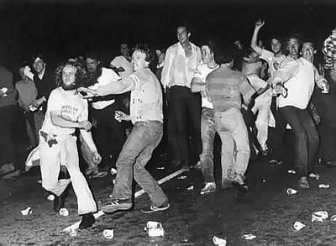
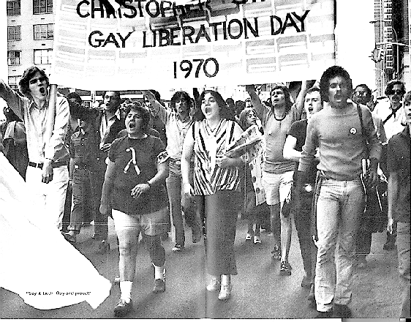
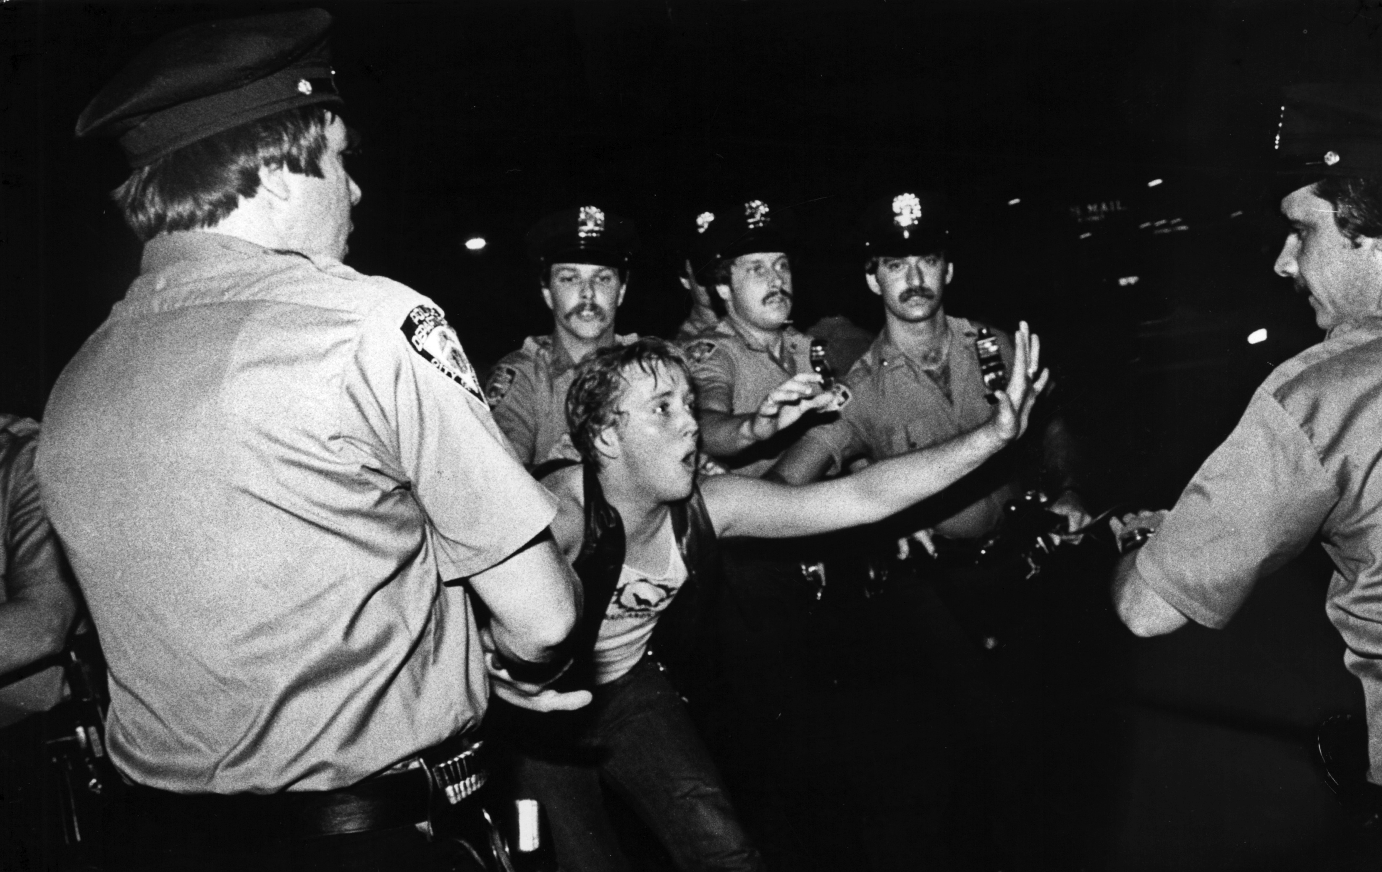
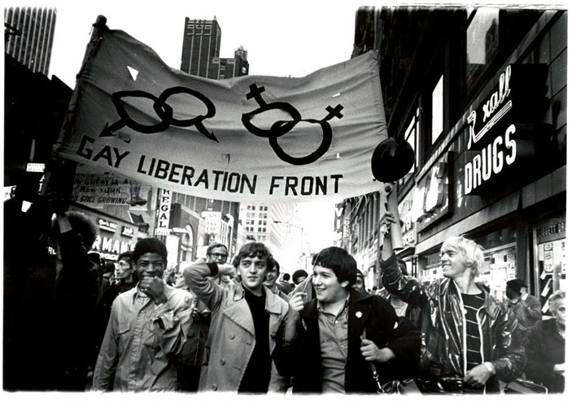
Stonewall Riots

Slide 27
Organizations such as the Gay Activist Alliance and the Gay Liberation Front began exerting pressure and influence on state legislatures to repeal laws prohibiting homosexual conduct. As a result of the growth of the gay rights movement, the Democratic Party has included protection of gay rights as part of its platform, and several states have passed laws prohibiting discrimination against homosexuals in employment, housing, education, and public accommodations.
In Romer v. Evans (1996) the Supreme Court ruled that a Colorado constitutional amendment invalidating state and local laws that protected homosexuals from discrimination was unconstitutional because it violated the Equal Protection Clause of the Fourteenth Amendment.

Slide 28
The Elderly
Discrimination has also been an issue with the elderly. Job discrimination made it difficult for older people to find work. As a result, in 1967 Congress passed the Age Discrimination in the Employment Act, prohibiting employers from discriminations against individuals over the age of 40 on the basis of age.

Slide 29
Affirmative Action
Affirmative Action is a policy designed to correct the effects of past discrimination. Most issues of affirmative action are race or gender based. In 1978 the Supreme Court ruled in Regents of the University of California v. Bakke that the affirmative action quotas used by the University of California in their admissions policies were unconstitutional, and that Bakke had been denied equal protection because the university used race as the sole criterion for admissions.

Slide 30
In the more recent Hopwood v. Texas (1996) the Court struck down the University of Texas Law School’s admissions program, stating that race could not be used as a factors in deciding which applicants to admit to achieve student body diversity, to prevent a hostile environment at the law school, to counteract the law school’s reputation among minorities, or to end the effects of past discrimination by institutions other than the law of school.

Slide 31
In 2003 the Supreme Court ruled that universities within the jurisdiction of the Fifth Circuit can use race as a factor in admissions as long as quotas are not used. In recent court decisions the court seems to be taking a more conservative view of affirmative action programs and many fear that affirmative action is on the decline.

