Slide 1
Reconstruction
* Presidential and Radical Reconstruction
** Southern state governments: aspirations, achievements, failures
*** Role of African Americans in politics, education, and the economy
**** Compromise of 1877
***** Impact of Reconstruction

Slide 2
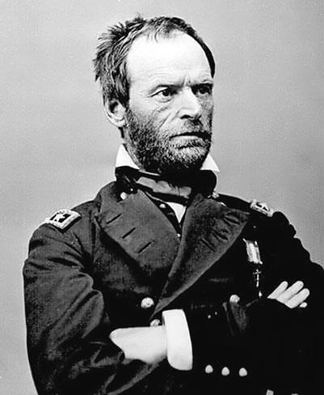
Reconstruction: Rebuilding the South
1. Under what restrictions would the Southern states be readmitted to the Union?
2. What would be the political/ social status of blacks (freemen)?
3. What should be done with rebels? Soldiers who fought? Leaders of the Rebellion?
Sherman

Slide 3
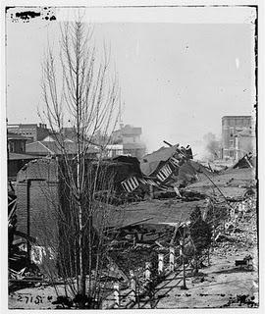
Reconstruction:
-Period during which the U.S. began to rebuild after the Civil War
-Physical rebuilding of the Southern cities & infrastructure
-Incorporating the South in the Congress
-Military occupation by the North in the South
-Integrating blacks into society
-Lasts from end of Civil War to the withdrawl of Union troops from North (1865-1877)

Slide 4
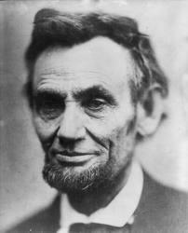
Lincoln vs. Congress
-Lincoln wished to make the South's return to the Union as quick and easy as possible
-Republican Party divided into:
-Radical Republicans who sought to punish the South
(destroy political power of former slave owners and wanted to give African-Americans the right to vote)
-Moderate Republicans that want to re-enfranchise the South
*President, VP, and Congress all had different ideas on how Reconstruction should be handled

Slide 5
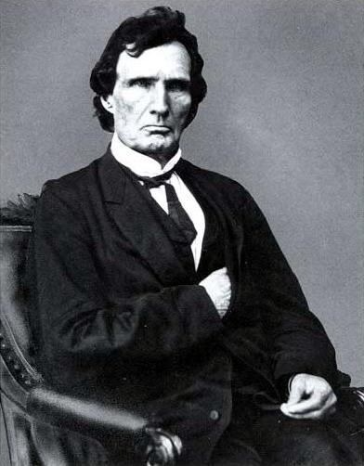
Who should have power over Reconstruction of the South?
Thaddeus Stevens
The USC does not make this unforeseen issue clear!
-Democracy had to figure this one out...
-President is the Commander-in-Chief of the military who is occupying the South and he is the Chief Executive...
-Congress makes all laws, including those in federal territories...
-Who should have power???

Slide 6
Lincoln's Ten-Percent Plan (aka: Proclamation of Amnesty and Reconstruction)
Lincoln wanted a more moderate approach to enfranchise Southern States Including:
1. 10% of the voters who participated in the Election of 1860 had to swear allegiance to US government (10% Plan)
2. Southern States could then reorganize state governments and reapply to Congress for admission to the Union
3. Had to approve of the 13th Amendment (12/1865) which freed slaves but guaranteed them no rights!

Slide 7
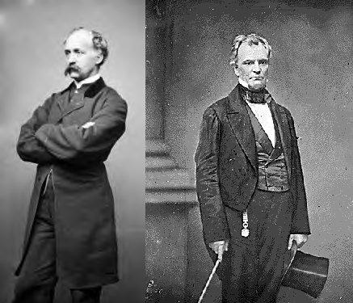
Wade-Davis Bill 1864: Lincoln Vetoed it
-Radical Republicans plan to punish the South and limit their power
1. Southern states ruled by a federally appointed governor until 50% of the population swear allegiance to the Union
2. State assemblies would be held where each state would repeal its bill of secession and repeal slavery
-Lincoln Pocket Vetoes the bill while Congress is out of session and kills it!
-He is then assassinated and VP Andrew Johnson is president!

Slide 8
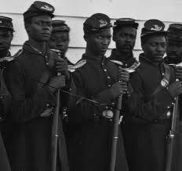
Blacks are ignored by legislation
-Wade-Davis Bill, and all other federal legislation said nothing about giving blacks rights or about giving them the vote
-Northern Congressmen largely ignore black rights
-Want to abolish slavery, but not necessarily make them "as equal as white men"
-Many Northern states had no slavery BUT also no political inclusion of blacks and do not seek it!

Slide 9
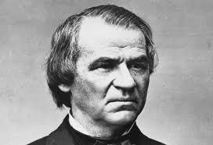
Andrew Johnson
-Was the sole Southern Senator who refused secession and refused to give up his Senate seat
-Lincoln rewards him by naming Johnson his VP in Election of 1864
-Also a political move that hoped to show reconciliatory feelings between Lincoln and the South
-Self-made man born of poor immigrant parents
-Owned two slaves
-Strong dislike for Southern Aristocracy
-Saw himself as the champion of poor white men

Slide 10
Presidential Reconstruction
1. military governments would run Southern states until they created new governments
2. a loyalty oath had to be sworn by Southern states in order to receive amnesty
-Southern plantation owners, officers, government officials could not take this oath, and thus not take offices in the new governments. Needed a special pardon from the president
3. States would hold conventions to write constitution that included provisions to abolish slavery and renounce secession
-DID NOT have to enfranchise blacks!
4. HOWEVER he pardoned many former Southern leaders who then assumed offices in the new governments!!!
**Within months, all states except TX met the requirements to reenter the Union
When Lincoln was killed and Johnson assumed the presidency
-Congress was on recess for the next eight months!
-He enacts his own brand of Reconstruction, based on the one Lincoln constructed:

Slide 11
Pardon......New seat in Congress?!
58 previously sat in the Congress of the Confederacy
6 had served in Confederate Cabinet
4 had fought against the Union as Confederate Generals

Slide 12
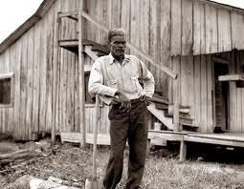
Failure of Presidential Reconstruction
Former Confederate leaders abolish slavery and seek to repress blacks as much as possible!
-Black Codes: defined Freedmen's status
1. limited rights to assemble and travel
2. instituted curfew laws
3. required freedmen to carry passes and identification
4. replaced "slaves" with "freedmen"
5. Southern Senators included the VP of the Confederacy and other officers
6. Northern Congressmen refused to admit the new Senators
7. Congress takes control of Reconstruction!

Slide 13
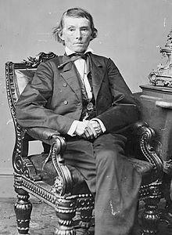
Congressional Reconstruction
-Civil Rights Act of 1866 became the first legislation ever enacted over a presidential veto
-Congress drafted the Fourteenth Amendment (1868)
-forces the passage of the Thirteenth Amendment as a provision of reentering the Union
-Some advocated for "40 acres and a mule," but it was never enacted. Confiscate southern land
-pitted Congress against Johnson
Alexander Stephens

Slide 14
Johnson Angers Congress
Freedman's Bureau Act-
Established in Congress to assist former slaves and poor whites in the South by distributing food and clothing
- Also set up 40 hospitals, approx 4,000 schools, 61 industries, and 74 teacher-training centers
Civil Rights Act of 1866-
Gave African Americans citizenship and forbabe states from passing discriminatory laws (black codes)
**Johnson vetoed both of these saying it went beyond the realms of the Constitution
ANGERS MODERATE AND RADICAL REPUBLICANS!

Slide 15
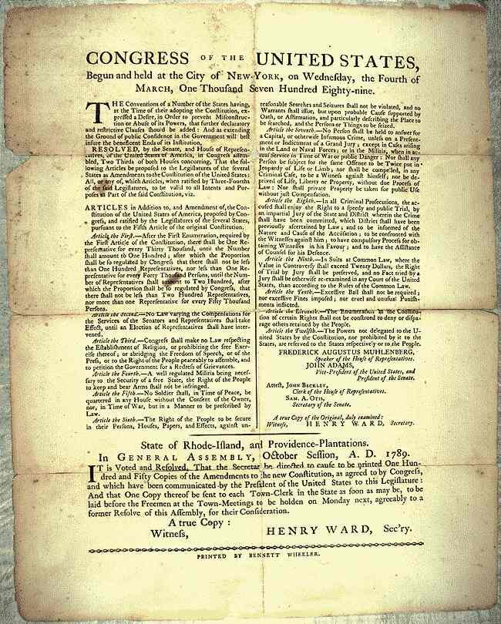
The Fourteenth Amendment:
1. if born in the US, you are a US citizen and a citizen of the state in which you were reside
2. STATES cannot prohibit "life, liberty, or property without due process of law"
3. prohibition of STATES denying "equal protection under the law"
4. gave states the option of giving freedmen the right to vote or to stop counting them as population
5. No Confederates in political offices
6. Assumed Confederate war debt
-Johnson actively campaigned against it!
-Congressional Election of 1866 places more Radical Republican in Congress
STATES, STATES, STATES!

Slide 16
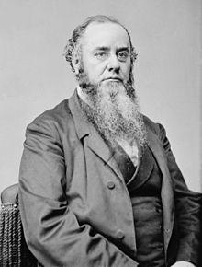
Impeachment of Andrew Johnson
Johnson and Congress were at odds over Reconstruction
-Johnson vetoed bills which Congress over-rode
-Congress sought to limit his power
Tenure in Office Act (1867):
-Trap to Impeach Johnson
-said he could not fire appointees once they were approved of by Congress
-he fired Edwin Stanton
-Johnson then gets Impeached
-Acquitted in the Senate by a single vote, but he lost the power to govern effectively!
Edwin M. Stanton

Slide 17
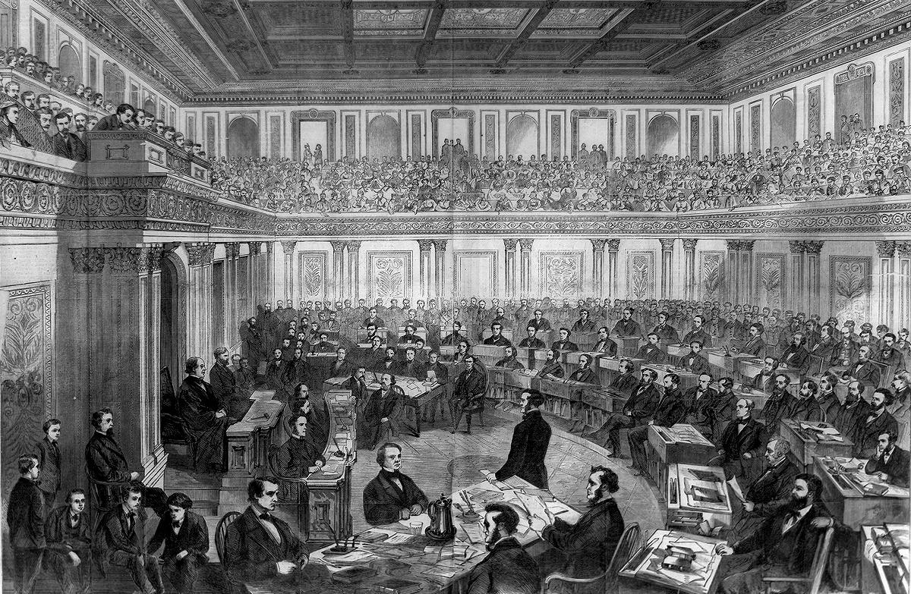
Senate Impeachment Trial of Johnson

Slide 18
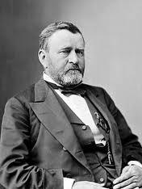
Ulysses S. Grant
(18th)
Victor of the Civil War
-seen as docile by Congress
-African American vote wins Grant the popular vote!
Fifteenth Amendment is passed while Grant is in office
-Requires blacks to have the vote
-Southern States had to ratify it as a provision of reentry into the Union
-many Northern states do not ratify it! But it passes...

Slide 19
15th Amendment
Granted African American men the right to vote by declaring that the "right of citizens of the United States to vote shall not be denied or abridged by the United States or by any state on account of race, color, or previous condition of servitude."
Although ratified on February 3, 1870, the promise of the 15th Amendment would not be fully realized for almost a century. Through the use of poll taxes, literacy tests and other means, Southern states were able to effectively disenfranchise African Americans.
Enforcement Act of 1870: Gave the Federal Gov't more power to punish those who tried to prevent African Americans from exercising their rights

Slide 20
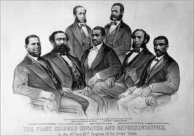
Successes of Reconstruction
1. Federal enforcement of Universal manhood suffrage in all states
2. Replaced many appointed officials with elected ones
3. Brought the Reform Movement to the South
-public schools
-orphanages
-mental institutions
4. Brought infrastructure to the South through loans, grants, tax exemptions, etc.
5. Blacks serving in state and federal congresses (at least at first!)

Slide 21
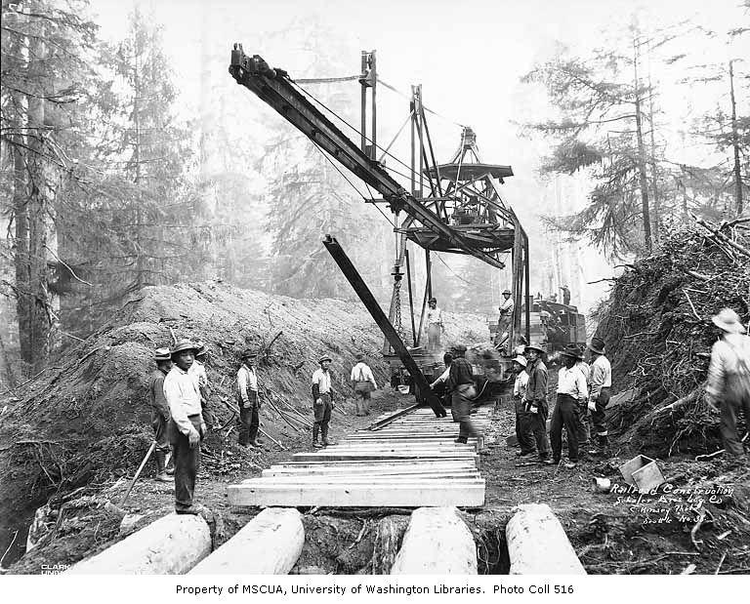

Slide 22
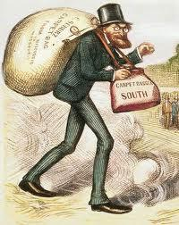
Terms....
Scalawags-White Southerners who joined the Republican party
*Hoped to gain freedmen vote and then use political office to improve their own conditions
Carpetbaggers- Northerners who moved to the South after the war
*Many believed Carpetbaggers were going to exploit the South

Slide 23
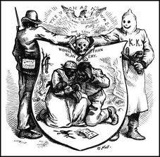
Ku Klux Klan
Kuklos is Greek for "circle"
-Formed by Confederate veterans specifically for initiating a war of terror on blacks
-Murdered carpetbaggers, scalawags, blacks and especially black leaders, Republicans, teachers, etc.
-Goal was to restore White Supremacy
-Public and demeaning lynch mobs
-Often composed of prominent members of society

Slide 24
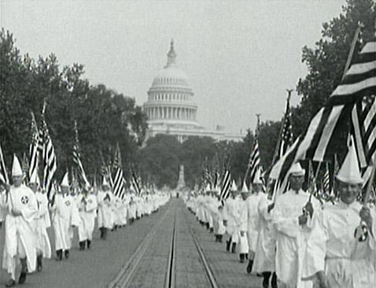

Slide 25
Enforcement Acts
To end Klan violence and Democratic intimidation The Enforcement Acts of 1870 & 1871 were passed
Provided for Federal Supervision of elections in Southern States
Gave President the power to use Federal troops in areas threatened by the KKK
**Deemed unconstitutional in 1882, but by this time Terrorist groups had managed to restore white supremacy throughout the South

Slide 26
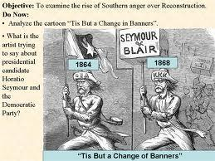
Reconstruction Utterly Fails!
High Taxes are required to reconstruct the South
-Propaganda war against Reconstruction
-Carpetbagger Northerners run Southern governments and make fortunes at the expense of Southerners
-Corruption runs rampant!
-Grant's administration is riddled with corruption, graft, scandal and ineffectiveness

Slide 27
Scandal Distracts Reconstruction Effort
Whiskey Ring
-Bribed federal and state officials to avoid millions of dollars of taxes
-Defrauded the Fed. Gov't of millions of Dollars
-238 men involved
-Grant's personal secretary was involved
Both cause people to focus on politics and scandal rather than on important issues!
Credit Mobilier
-construction subcontractor of the United States
-overestimated contracts
-skimmed money of a gov't railroad contract
-filtered money to executives and politicians
-Involved Grant's VP!

Slide 28
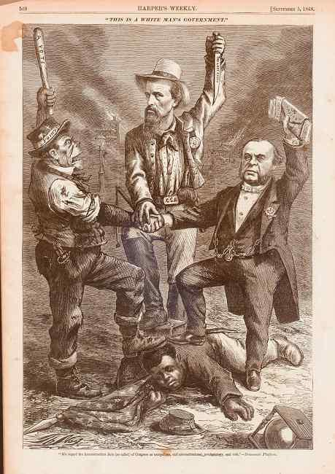
Reconstruction Fails:
-Terrorism works!
-Grant loosely enforces Reconstruction to help heal national wounds
-Blacks have de jure not de facto freedom
-White aristocracy still own land, wealth, and power
-Poor blacks have no skills, education, options and continue to work on former slave owners' land sharecropping
-Blacks are forced out of political offices in the South

Slide 29
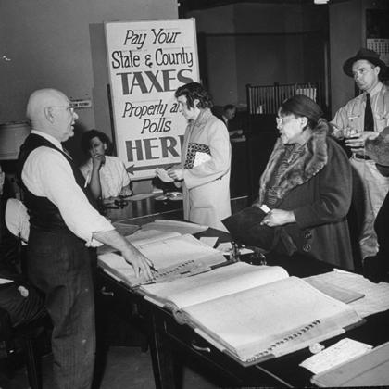
The Supreme Court Fails to Enforce Reconstruction
US v. Cruikshank- 14th amendment did not give the fed. gov't the right to punish individual who oppressed blacks
US v. Reese allows states to restrict voting with:
-grandfather clauses
-poll taxes
-literacy tests
-property requirements
-blacks to be disenfranchised in the South

Slide 30
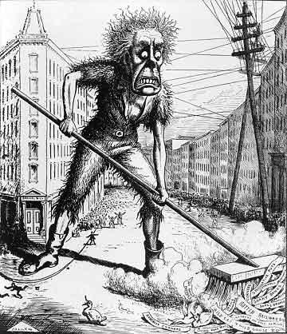
Congress Bails on Reconstruction:
-Liberal Republicans formed and abandon Reconstruction as a failure and state issue
-Angered by corruption, wanted to end Federal occupation of the South
-Gain seats in Congress
-This causes Grant to move further from enforcement of Reconstruction
-Amnesty Act allows many former Confederates to enter political offices!
-financial Panic of 1873 draws attention away from Reconstruction

Slide 31
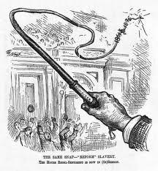
Southern Democrats take over state legislatures
-Call themselves Redeemers
-Seek to recreate Old South
-Reconstruction is seen as financially, emotionally, and politically fragmenting the nation
-Reconstruction policies and freedoms are practically unenforced

Slide 32
Election of 1876:
Both Parties accuse the other of corruption
-Democrat and NY Governor Samuel J. Tilden needed 185 electoral college votes, but only gets 184!
-Republican Rutherford B. Hayes wins 165 and disputes LO, SC, FL EC votes which would give him 185 needed to win!
-They struck a secret deal that gave Hayes the Presidency if he promised to end Reconstruction!

Slide 33
Compromise of 1877:
Hayes ends Reconstruction
-Pulls federal troops out of South Carolina and Louisiana & appoints a conservative Southerner to the Presidential Cabinet.
-Democrats take control there and oppress blacks in horrific ways
-White supremacists were able to regain control of the South
-Civil Rights for black people would not begin to be enforced until Congress enforced the 13th, 14th, and 15th Amendments with an Act of Congress called the Civil Rights Act of 1964!

Slide 34
The Legacy of Reconstruction
Reconstruction ended without much real progress in the battle against discrimination
-Freedmen got civil rights but then no laws to help protect them
-Having no land hurt the freedmen because they could not become economically independent
-Failure to realize the deep seated racism of the South
Success:
-13th amendment ended slavery
-Passage of the 14th and 15th amendment
-Many colleges and volunteer organizations were created and many freedmen became literate

